Slide 1
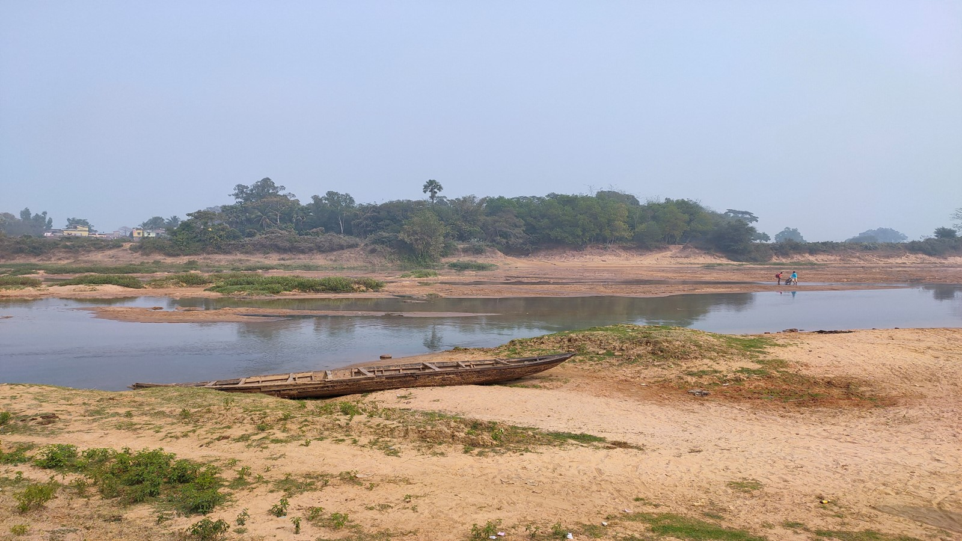
ASSESSMENT OF GROUNDWATER POTENTIAL ZONE WITH INTEGRATED MCDM MODEL AND WQI IN SILABATI-JOYPANDA RIVER BASIN OF WEST BENGAL, INDIA
BY
SAYAK KARMAKAR
EXAMINATION ROLL NO: M4WRE22020
REGISTRATION NO: 135835 OF 2016-17
UNDER THE GUIDANCE OF
PROF. (DR.) PANKAJ KUMAR ROY
PROFESSOR
SCHOOL OF WATER RESOURCES ENGINEERING
JADAVPUR UNIVERSITY
ME (WATER RESOURCES AND HYDRAULIC ENGINEERING)
COURSE AFFILIATED TO
FACULTY OF ENGINEERING AND TECHNOLOGY
JADAVPUR UNIVERSITY
KOLKATA- 700032
WEST BENGAL, INDIA

Slide 2

OVERVIEW
Introduction
Objectives
Literature review
Materials and Methodology
Development of Thematic Maps
Results and Discussions
Validation of the result
Water Quality Assessment
Conclusions and References

Slide 3
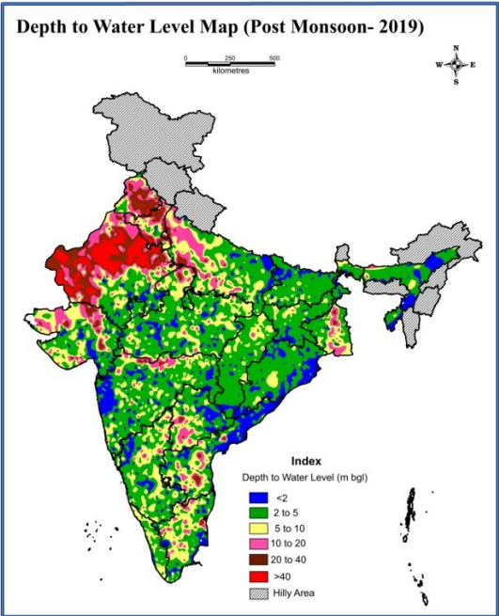
INTRODUCTION:
Current Groundwater Scenario in India
Groundwater or subsurface water occurs below the surface of the earth and originates from infiltration, seepage from the reservoirs, influent streams, artificial recharge etc.
Groundwater is a very important source of drinking and irrigation water in rural and urban areas.
Usable water resources of the country have been estimated as 1,123 BCM/year.
Out of the 1,123 BCM/year, the share of surface water and groundwater is 690 BCM/year and 433 BCM/year respectively
Due to the increasing population in the country, the national per capita annual availability of water has reduced from 1,816 cubic meter in 2001 to 1,544 cubic meter in 2011.

Slide 4
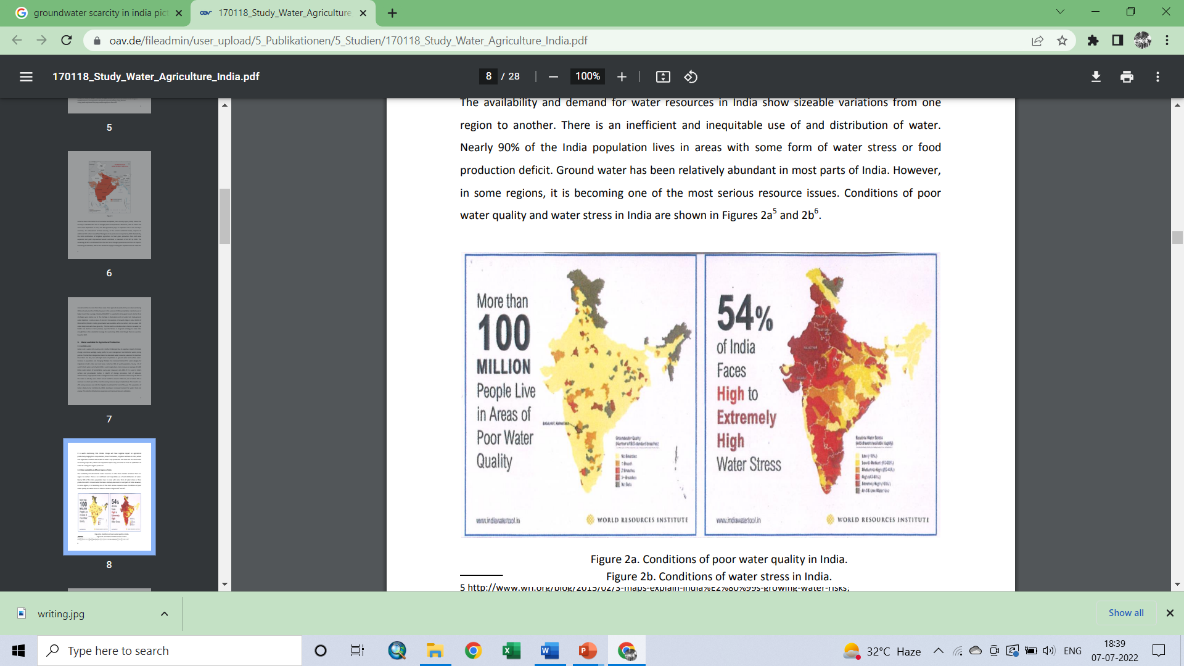
Reasons for groundwater depletion
Increased population and Increased demand.
limited storage facilities owing to the hard rock terrain.
Lack of rainfall.
Green Revolution enabled water-intensive crops to be grown in drought-prone/ water deficit regions.
Due to overexploitation of groundwater for agricultural and irrigation purposes.
Water contamination.
Inadequate regulation of groundwater laws.
Deforestation, unscientific methods of agriculture, chemical effluents from industries.

Slide 5
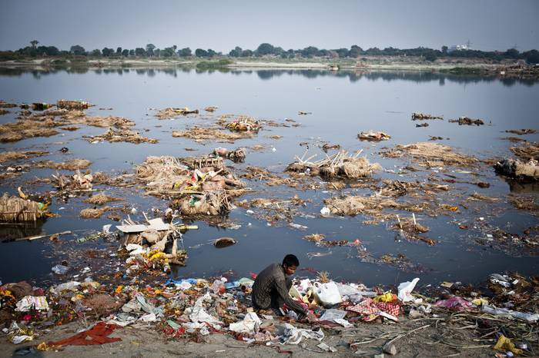
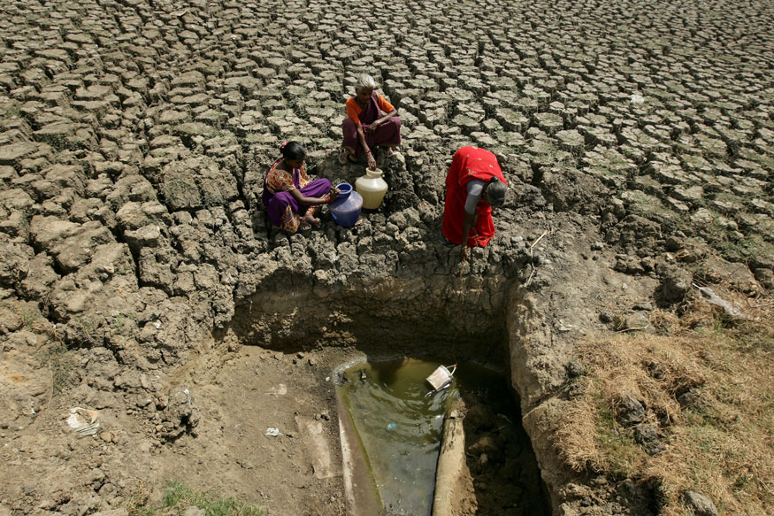
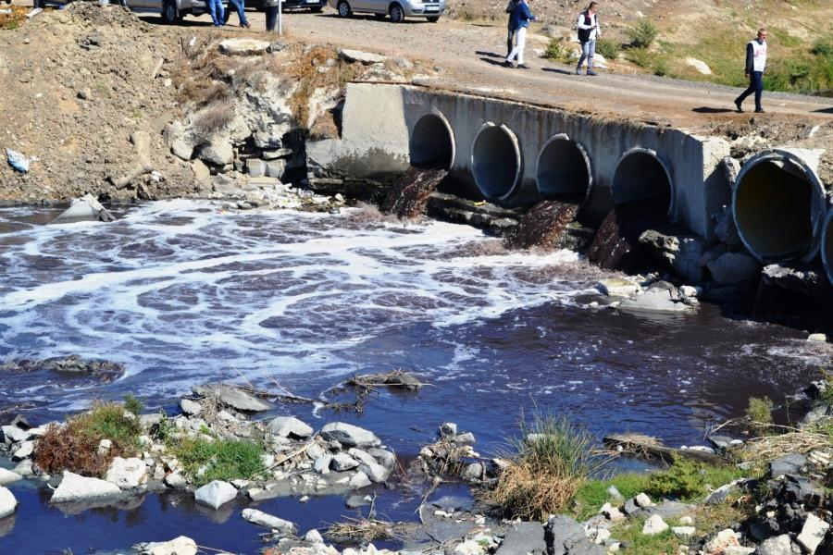
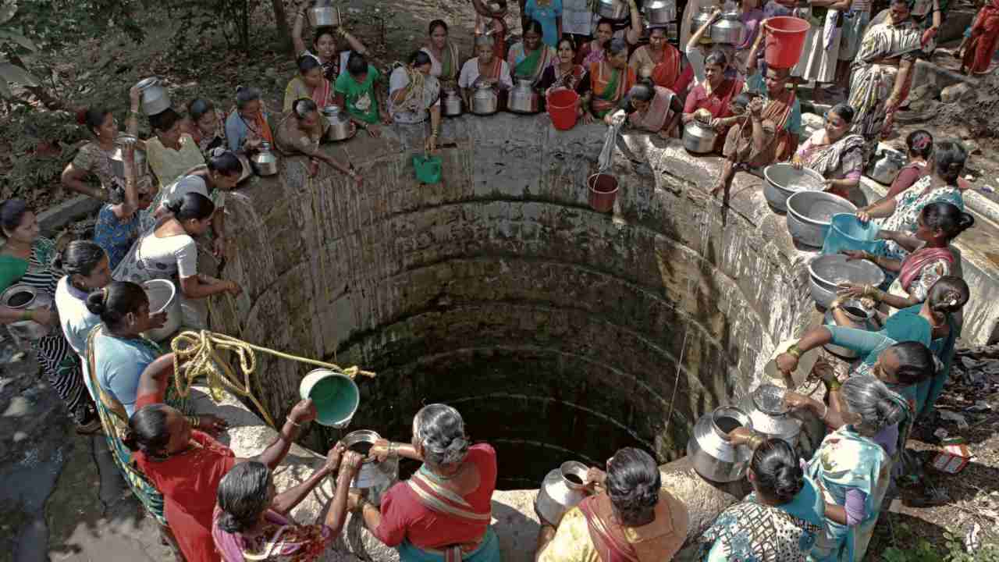
Pollution of surface water is an important reason for groundwater contamination
Scarcity of groundwater in Indian rural areas

Slide 6
LITERATURE REVIEW
International Research Papers
Author(s) | Journal Name | Year | Title | Major Findings
Fashae et al. | Appl Water Sci | 2014 | Delineation of groundwater potential zones in the crystalline basement terrain of SW-Nigeria: an integrated GIS and remote sensing approach | RS, GIS techniques, and Analytical Hierarchy Process have been used. Total of nine parameters were used (Geology, Rainfall, Geomorphology, Soil, Drainage Density, Lineament Density, Land Use, Slope and Drainage Proximity) Model validation using borewell yield data.
Aouragh et al. | GEOMATICS, NATURAL HAZARDS AND RISK | 2016 | Groundwater potential of Middle Atlas plateaus, Morocco, using fuzzy logic approach, GIS and remote sensing | GIS and RS techniques, and Fuzzy AHP were used to delineate the final map. Number of parameters used is six (lithology, slope, Karst degrees, land cover, Lineament and drainage density). Model validated using yield data of 64 bore wells.
Behzad et al. | Carbonates and Evaporites | 2018 | Delineation of groundwater potential zones using remote sensing (RS), geographical information system (GIS) and analytic hierarchy process (AHP) techniques: a case study in the Leylia–Keynow watershed, southwest of Iran. | GIS & RS techniques and AHP were used. The total number of parameters was five (rainfall, lineament density, lithology slope, and drainage density). Model was validated using the existence of springs and sinkholes in the study area.

Slide 7
Research papers on Indian Background
Author(s) | Journal Name | Year | Title | Major Findings
Halder et al. | Arabian Journal of Geosciences | 2020 | Fuzzy logic algorithm based analytic hierarchy process for delineation of groundwater potential zones in complex topography. | GIS & RS techniques and Fuzzy AHP were used. Total of 11 parameters were used (LULC, soil, geology geomorphology, lineament density, drainage density, relative relief, distance from river, slope, groundwater level fluctuation and normalised difference water index). Validated by groundwater level survey using TLC meter.
Das et al. | Environment, Development and Sustainability | 2020 | Assessment of groundwater recharge and its potential zone identification in groundwater-stressed Goghat-I block of Hugli District, West Bengal, India. | GIS & RS techniques, AHP and weighted overlay method were used to delineate the final GWPZ. Quantity of groundwater recharge measured by water level fluctuation (WLF) method. Total of six layers were used (geology, geomorphology, slope, soil, LULC and pond frequency. Model was validated by receiver operating characteristics (ROC) curve.
Magesh et al. | GEOSCIENCE FRONTIERS | 2012 | Delineation of groundwater potential zones in Theni district, Tamil Nadu, using remote sensing, GIS and MIF techniques. | GIS & RS techniques were used. Multi- influencing factor (MIF) technique was used for weightage calculation. Number of thematic layers was seven viz. lithology, slope, land-use, lineament, drainage, soil and rainfall.

Slide 8
Research Gap
Old works
Novelty of the current work
In most of the studies, maps of thematic layers were generated from satellite imageries and conventional maps
In this study, some of them were generated from field survey data.
Number of parameters to generate final map was less.
A total of 14 parameters were introduced.
Validation of the model was done in a few cases and most of them were done from groundwater level survey data.
Validation of the final map has been done by groundwater level survey and Vertical Electrical Sounding (VES) survey data.
No or a few water quality assessments were done in the study area.
General water quality parameters were measured in the laboratory of samples collected from the field & water quality index was determined.

Slide 9
THE OBJECTIVE OF THE STUDY
To delineate the groundwater potential zone (GPZ) of the Upper Silabati-Joypanda river basin of west Bengal, India by integrating surface and subsurface parameters with the help of GIS, Remote sensing and analytical hierarchy process.
SCOPE OF THE STUDY:
To validate the GPZ using resistivity survey and groundwater level data obtained from dug wells during the field survey.
To determine different soil characteristics of the study area like bulk density, specific gravity, water holding capacity, moisture content, permeability, dry density, sieve analysis, porosity etc and to introduce some of the parameters as thematic layers to delineate the groundwater potential zone.
To collect groundwater samples from different sites in the study area and to determine general water quality parameters as well as water quality index for quality risk assessment.
The study will help in effective water resources management and identify the suitable locations for groundwater extraction.

Slide 10
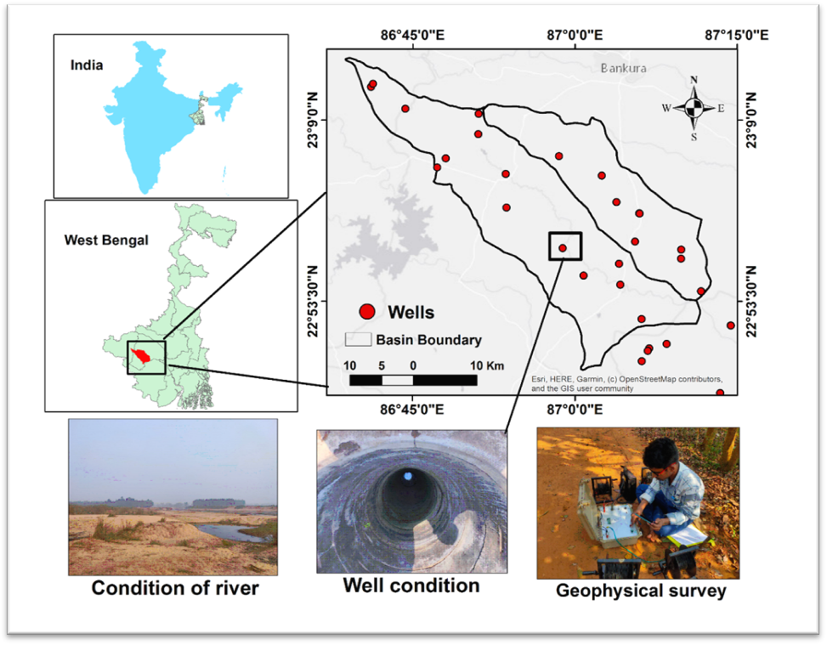
STUDY AREA
Location | Upper Silabati-Joypanda river basin
Area | 1099.32 km²
Latitudinal extent | 22 ͦ47’37.82” N to 23 ͦ14’18.03” N
Longitudinal extent | 86 ͦ38’46.08” E to 87 ͦ12’32.22” E
Districts covered | Bankura, Purulia and West Medinipur
Blocks covered | Bankura: Hirabandh, Indpur, Khatra, Taldangra, Simlapal, Sarenga, Onda. Purulia: Puncha West Medinipur: Garbeta-II
Source of Silabati river | A spring at Barogram in Puncha block, Purulia
Length of the river within the study area | 74 km (approx.)

Slide 11
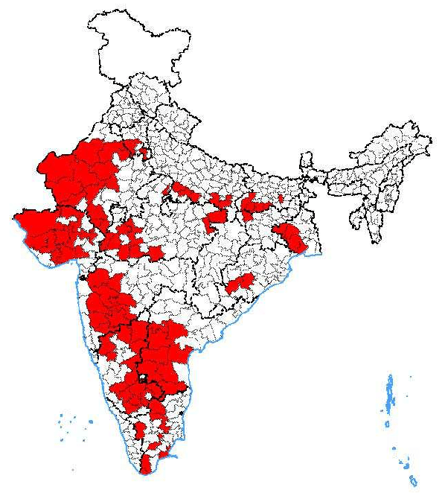
WHY SILABATI-JOYPANDA RIVER BASIN?
The basin area belongs to a semi-arid to a humid climate and is very much drought-prone. So, effective management of groundwater is much needed here to maintain a sustainable ecosystem.
Maps of drought-prone districts of India have been indicated here in red colour. From the map, it is obvious that the Silabati-Joypanda basin is in a drought-prone zone. (Source: researchgate.net)

Slide 12
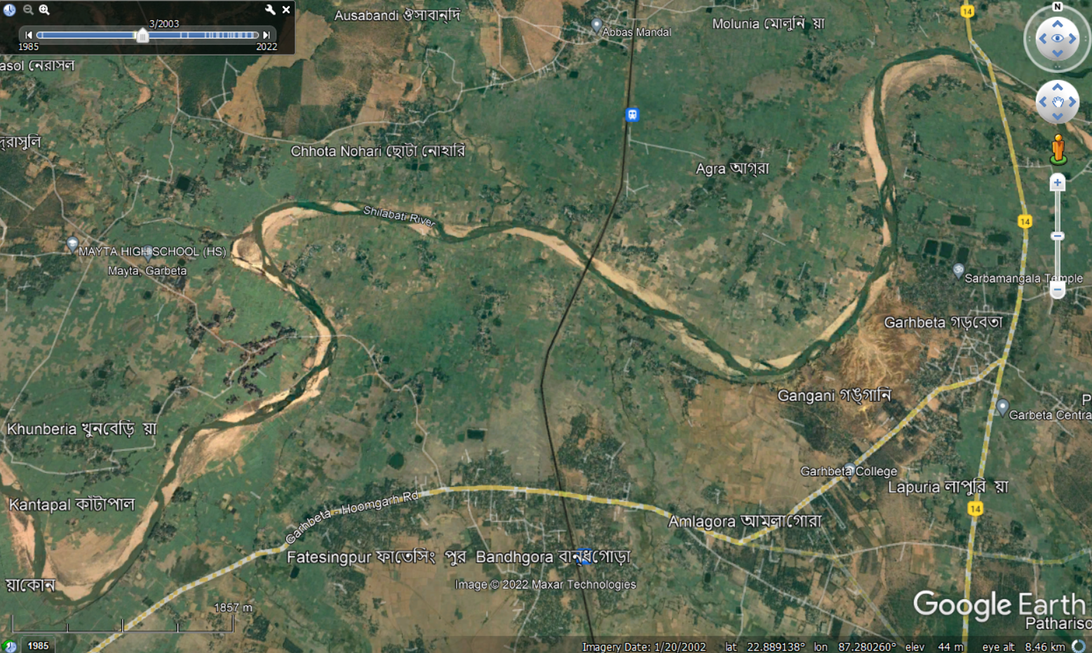
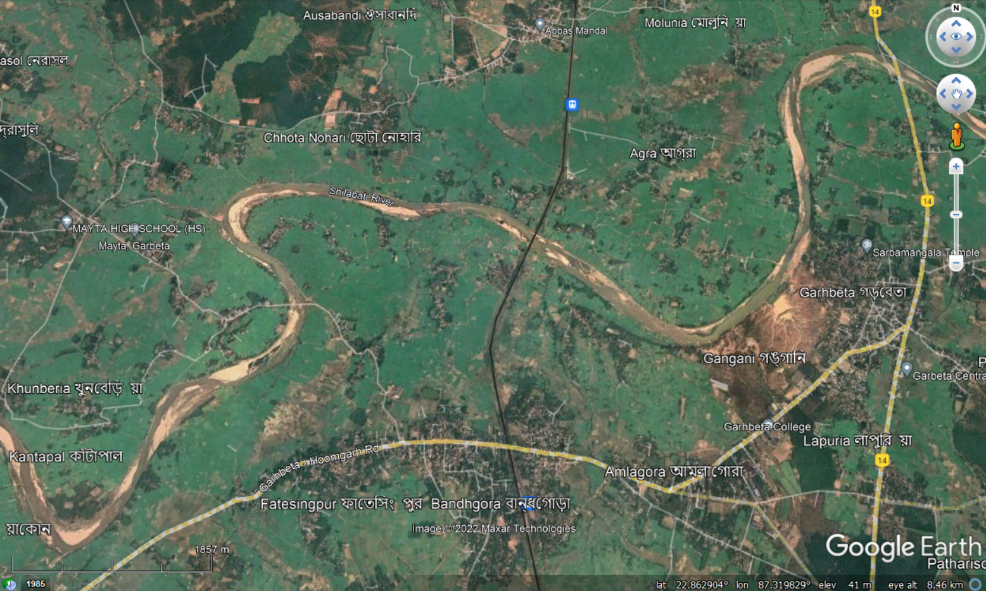
Drying river regime at Garbeta block, West Medinipur
Silabati is a non-perennial river. Most of the time in a year, it carries a very low discharge.
Furthermore, the width of the river is being contracted because of different anthropogenic activities.
So, it is difficult to irrigate the crops using surface water throughout the year. Groundwater is necessary for irrigation and agricultural purpose.
Image Source: Google Earth
March 2003
July 2022

Slide 13
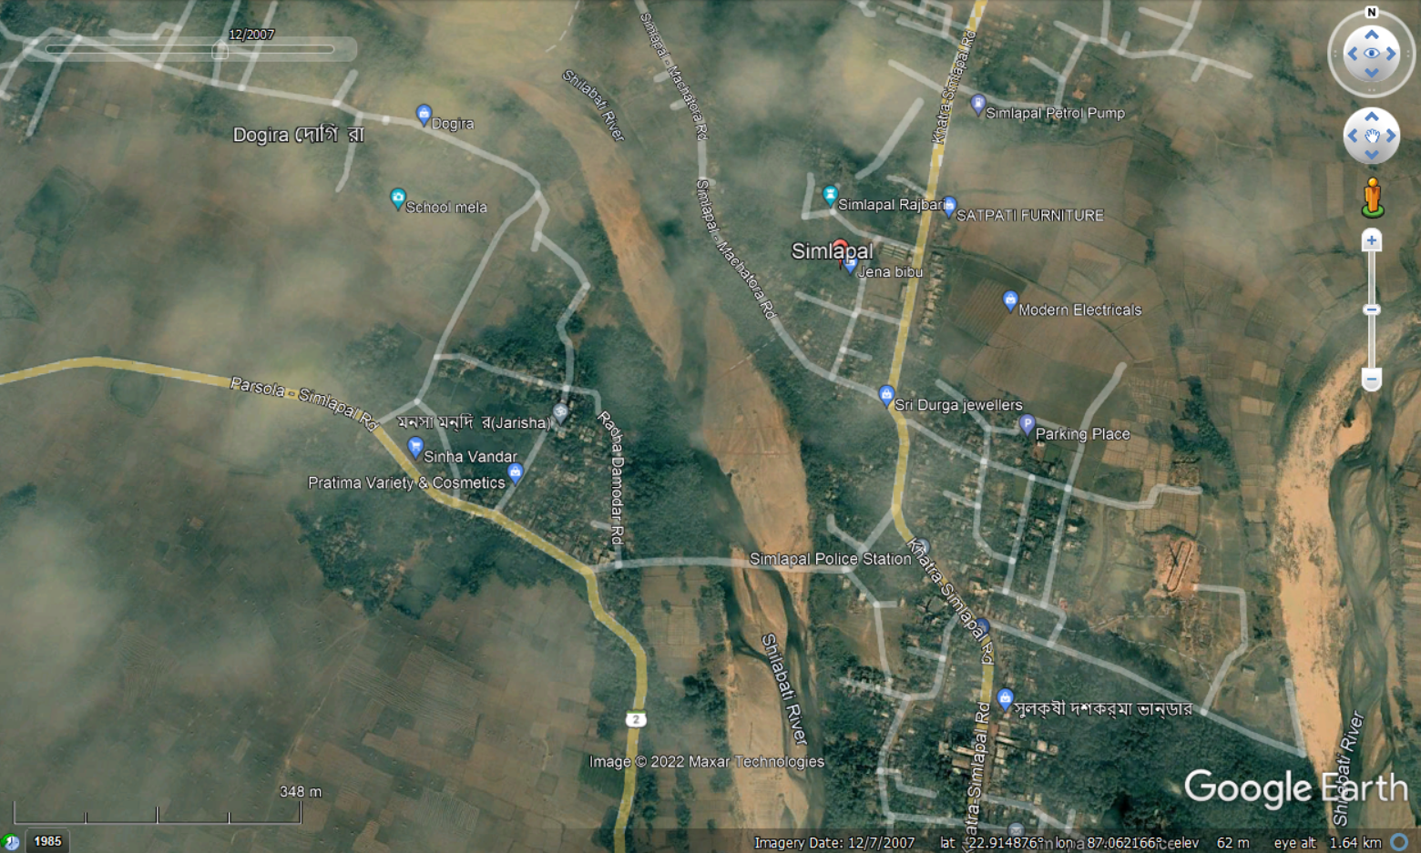
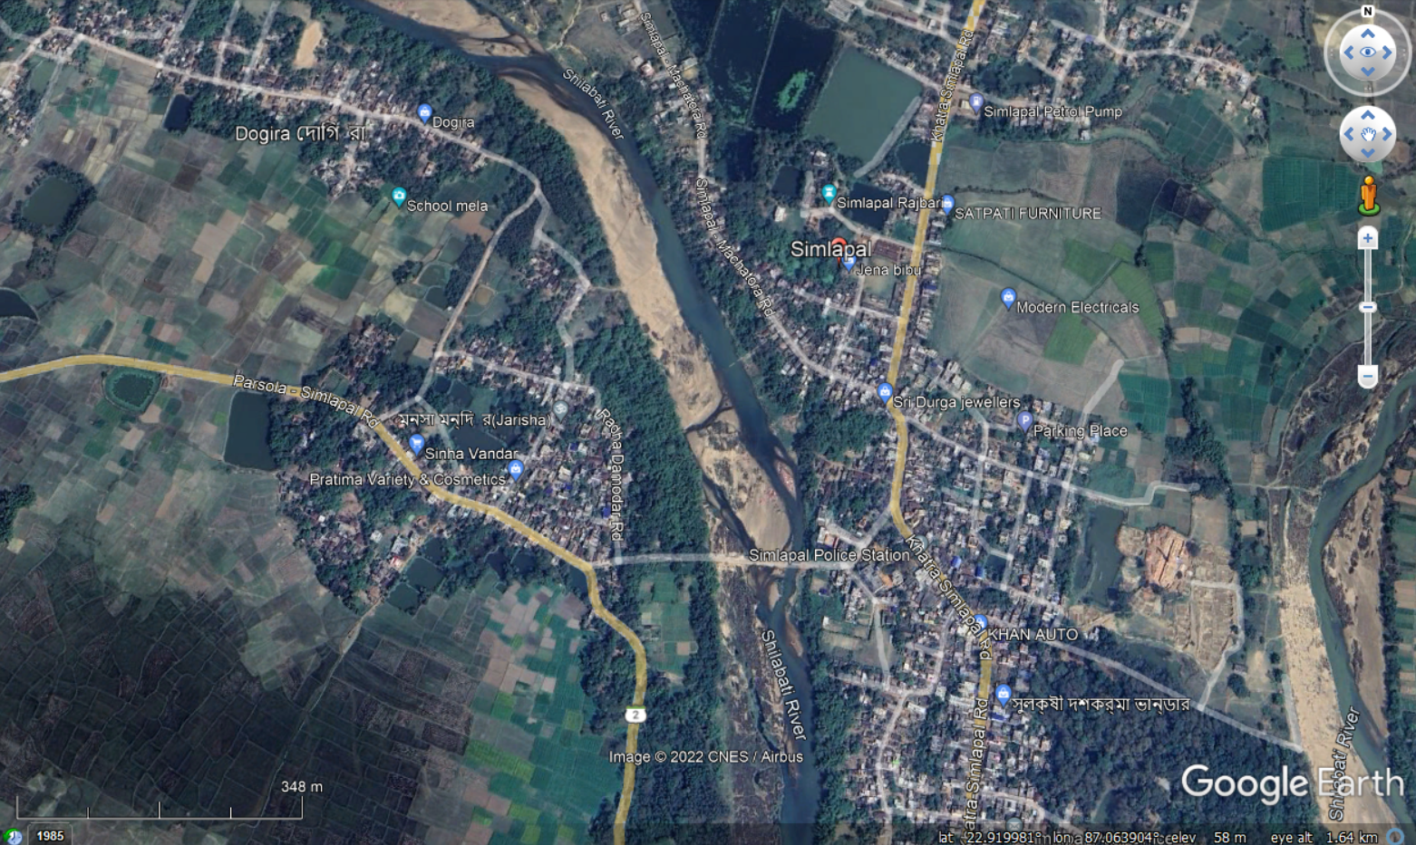
Increase of settlement at Simlapal block, Bankura
Human encroachment and increase in the built-up area decreases the groundwater recharge and hampers the ecological flow in an open channel.
Due to excessive population pressure, groundwater extraction is increasing and continuous declination of GWL has been observed.
Image Source: Google Earth
December 2007
July, 2022

Slide 14
SOURCE OF DATA TO GENERATE THEMATIC MAPS
Survey of India, topographical sheet numbers 73I/12, 73I/16, 73J/13, 73M/4, and 73N/1
Drainage Density Map
Geological Survey of India website (https://www.gsi.gov.in)
Geology Map
Geomorphological Map
SRTM DEM having a resolution of 30 m downloaded from the USGS Earth Explorer website (https://earthexplorer.usgs.gov)
Slope Map
Relative Relief Map

Slide 15
Landsat 8 OLI of path 139 and row 40, USGS Earth Explorer website
Land use and land cover map
Lineaments
Hydrogeological maps from PHED, Govt. of W.B. (http://maps.wbphed.gov.in)
Locations of dug wells having yield 50-100 LPM
CHIRPS dataset (https:/www.chc.ucsb.edu/data/chirps)
Rainfall Map
National Bureau of Soil Survey and Land Use Planning (NBSSLUP)
Soil Map

Slide 16
METHODOLOGY
Conventional maps and collection of database
Field survey generated data
Generation of thematic layer maps in ArcGIS
Porosity, Permeability and Water Holding Capacity measurement
Categorization & weight assignment by AHP
Integration of all the thematic layers in ArcGIS
Measurements of water quality parameters
Generation of final groundwater potential map
Validation using Pearson correlation coefficient
Execution of VES survey
Determination of water quality index by “Weighted arithmetic index method”
Curve matching & geoelectric layer identification
Validation of the model using VES data
Qualitative & quantitative assessment of GW of the study area

Slide 17
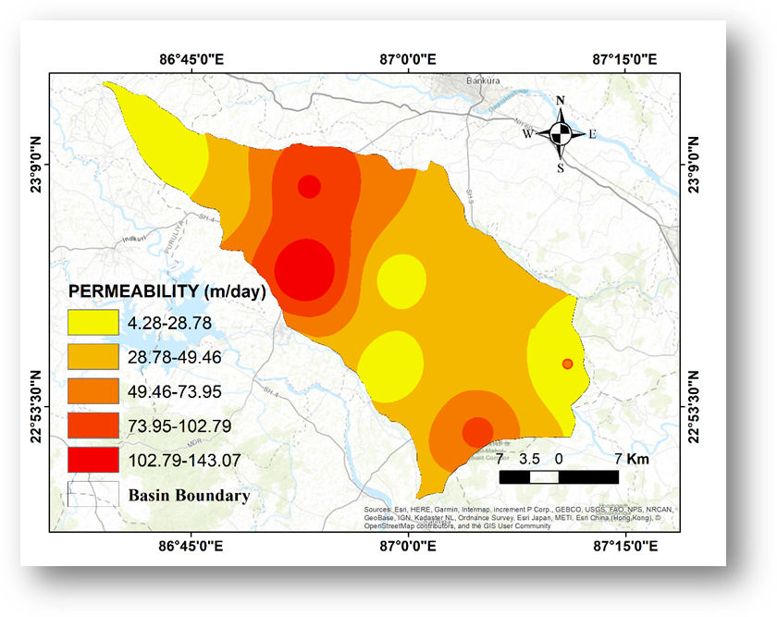
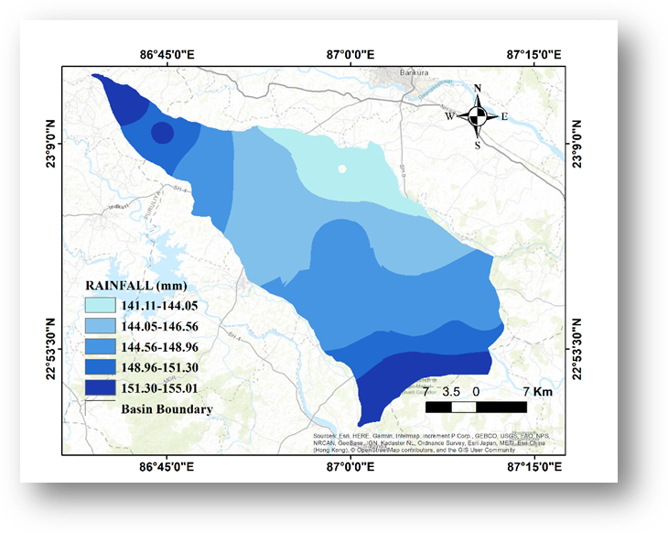
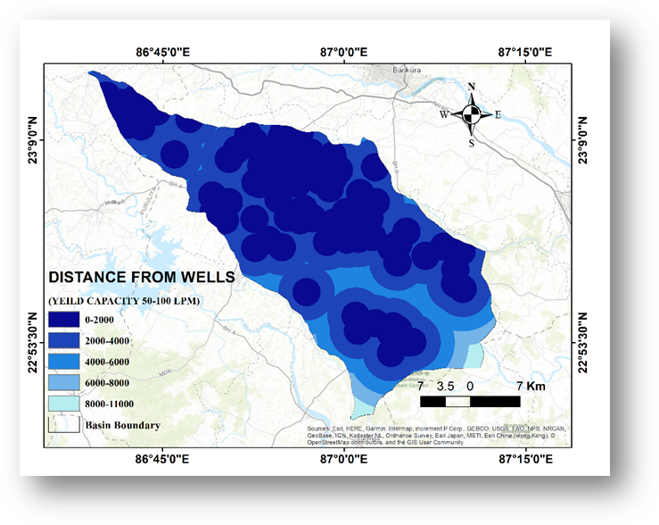
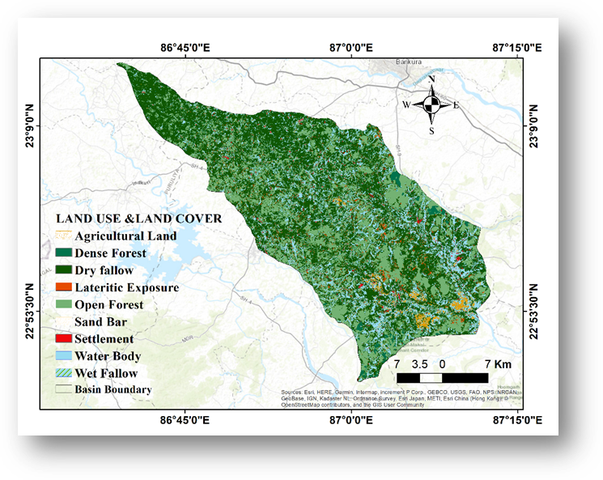
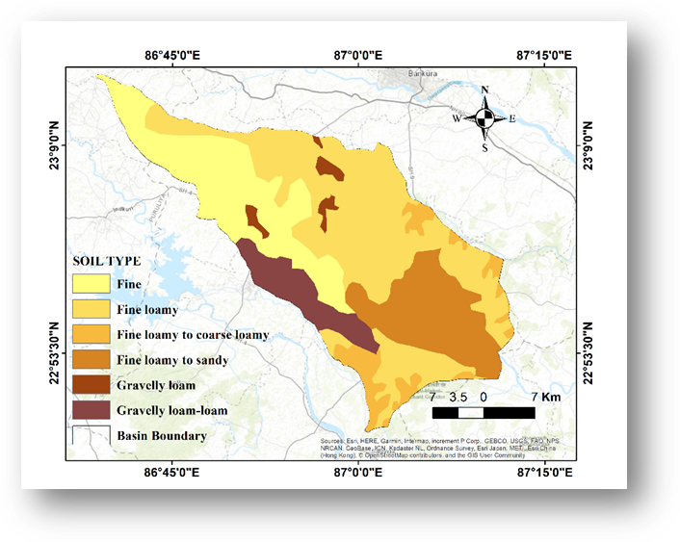
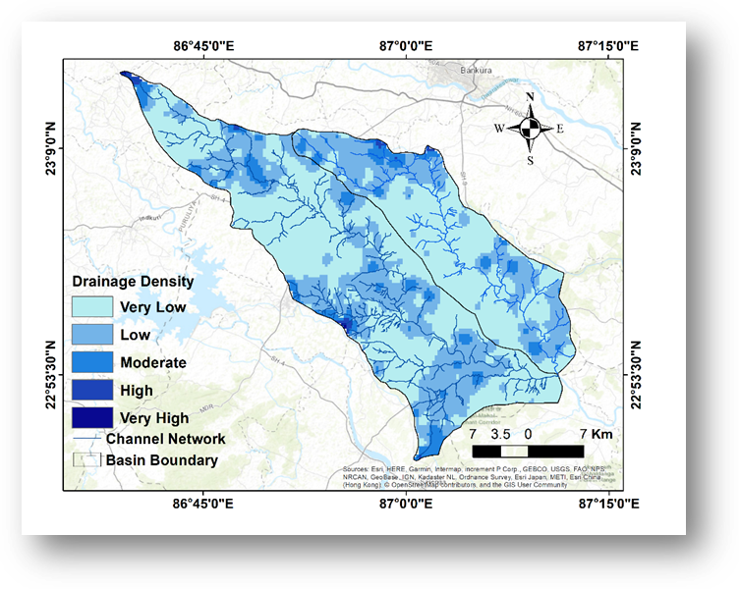
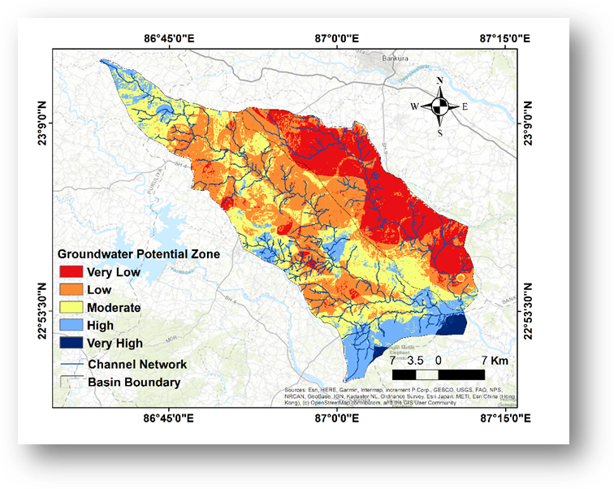
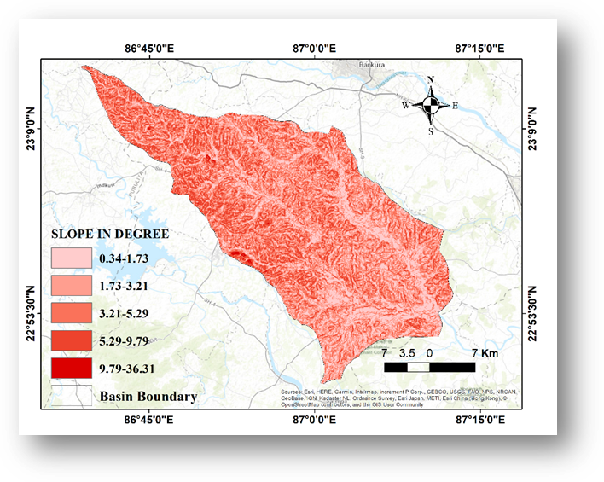
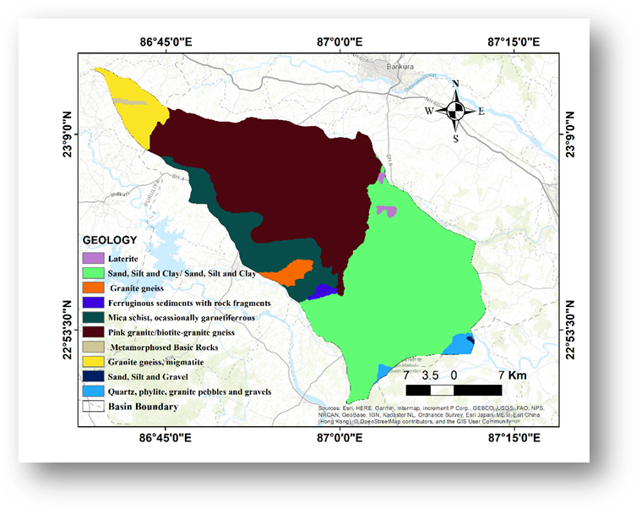
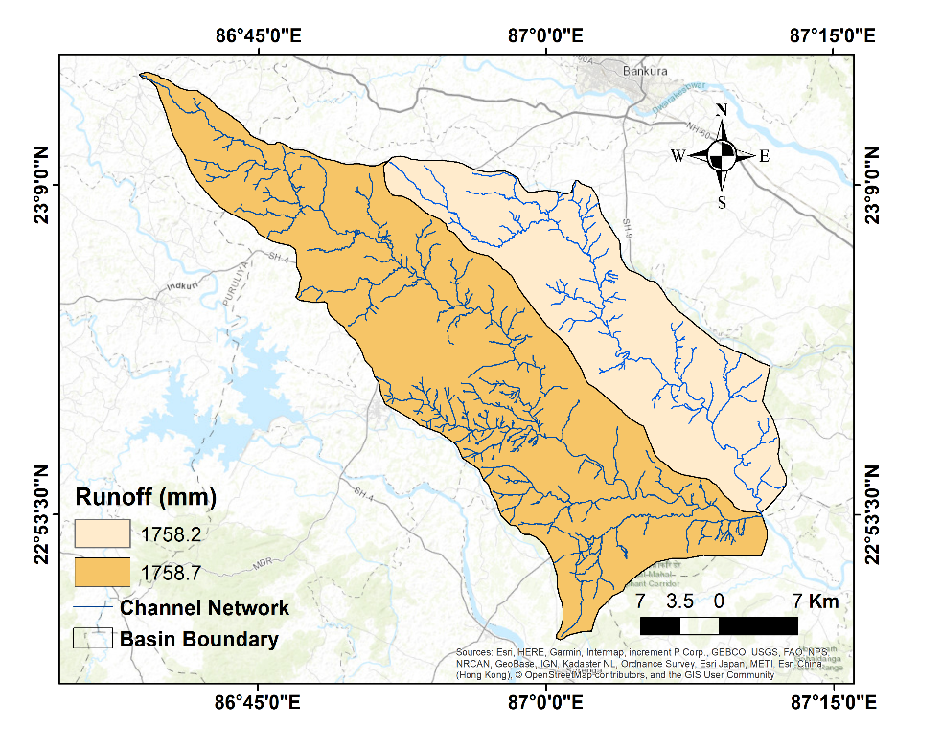
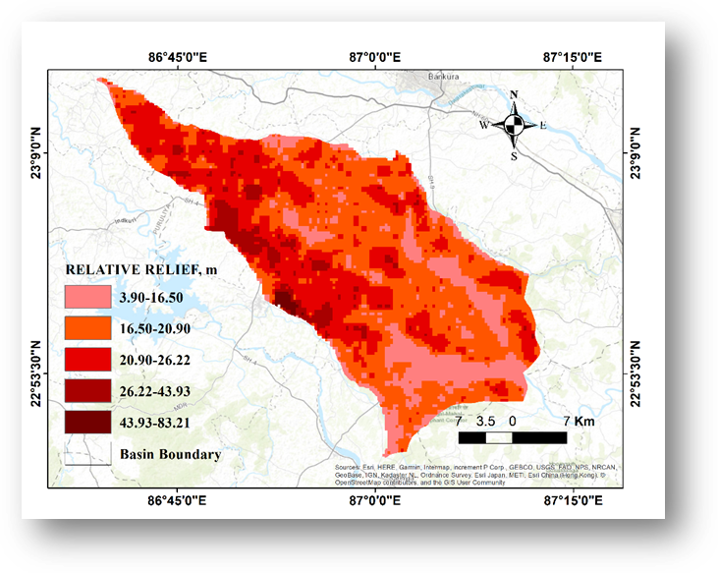
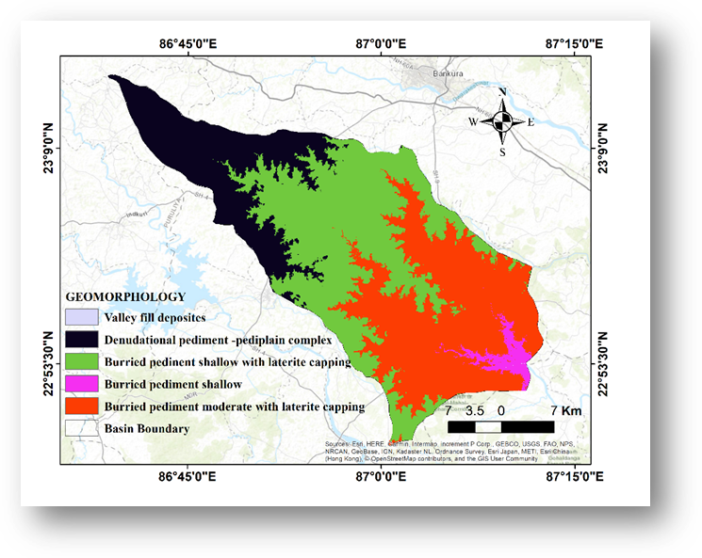
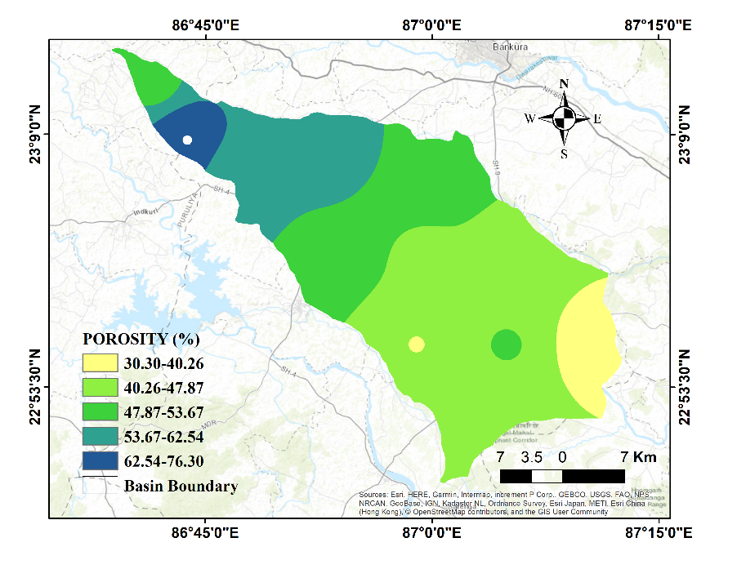
Thematic Layers Used to Get the Final Groundwater Potential Map
Drainage Density,
Geology,
Geomorphology,
Land Use and Land Cover,
Distance from Lineament,
Porosity of soil,
Runoff,
Rainfall,
Soil type,
Distance from Wells with High Yield,
Relative Relief,
Permeability of soil,
Slope,
Water Holding Capacity

Slide 18
SITES FOR SOIL AND WATER SAMPLE COLLECTION
Site name | Latitude | Longitude | Elevation (m)
Aralbara | 23.115 | 86.784 | 161
Bansidi | 23.127 | 86.885 | 141
Barogram | 23.249 | 86.579 | 196
Baromesya | 23.025 | 87.082 | 74
Bara Metala | 22.935 | 86.841 | 112
Dumuria | 22.764 | 87.169 | 81
Gharpathar | 23.110 | 86.985 | 113
Guniada | 23.144 | 86.730 | 182
Kantapal | 22.847 | 87.281 | 40
Kawabasa | 23.111 | 87.114 | 95
Kolaboti (Susunia) | 22.865 | 87.080 | 85
Kusumdunri | 22.934 | 87.083 | 93
Kharjuria | 22.936 | 86.983 | 98
Metyal | 22.757 | 87.115 | 94
Niasa | 23.203 | 86.693 | 186
Pachaparar | 22.938 | 87.183 | 74
Poradi | 23.119 | 86.665 | 167
Rampur | 23.028 | 86.988 | 100
Upar Maity Bandh | 23.036 | 86.882 | 134

Slide 19
ANALYTICAL HIERARCHY PROCESS (AHP)
AHP is an efficient, group decision-making mathematical matrix-based technique that helps a user to compute the relative weight of multiple criteria.
AHP technique was developed by Saaty in the year 1970 (Agarwal et al. 2013).
To develop an AHP model, first, we have to set a goal at the top level, the attributes/criteria at the second level, and alternatives at the 3rd level.
Pairwise comparison matrix is created with the help of a scale of relative importance that has been shown here.
Scale | Importance
1 | Equal importance
3 | Moderate importance
5 | Strong importance
7 | Very strong importance
9 | Extreme importance
2,4,6,8 | Intermediate values

Slide 20
Process Flow of AHP
To define the objective of the problem
Rearrangement of all the problems into a hierarchical structure
From the literature review, field experience and expert opinion, making a pair-wise comparison matrix
Convert the pair wise comparison matrix to normalized pair wise Comparison matrix
To find the value of the consistency index and consistency ratio and to check whether CR value is less than 0.1 or not
If the CI value is less than 1, then the assigned weights are okay. Otherwise, repeat step 3.

Slide 21
Pairwise comparison matrix

Slide 22
Normalized Pairwise Comparison Matrix

Slide 23
Consistency Matrix

Slide 24
λmax = Average of all (Weighted sum value/Criteria Weight)
=15.938
Consistency Index= (λmax –n)/(n-1)
=0.03358
Number of variables | 1 | 2 | 3 | 4 | 5 | 6 | 7 | 8 | 9 | 10 | 11 | 12 | 13 | 14 | 15
Random Index | 0.00 | 0.00 | 0.58 | 0.9 | 1.12 | 1.24 | 1.32 | 1.41 | 1.45 | 1.49 | 1.51 | 1.48 | 1.56 | 1.57 | 1.58
Consistency Ratio = Consistency Index / Random Index
= 0.03358/1.57
=0.0949 < 0.1
So, this AHP matrix is reasonably consistent.

Slide 25
Generation of Thematic maps
1. Drainage Density
It refers to the closeness of the steams or different channels per unit area of a basin.
Drainage density is inversely proportional to the groundwater recharge.
Drainage density for the study area has been calculated using the Hortons method (Horton 1945) expressed as:
D_{d} =L/A
Where L= total length of the stream in km and
A= Area in km².
Generally, places near the stream network can be observed as areas with high drainage density values.
Class (Drainage density in Km/sq. km) | Groundwater potential | Sub criteria Weight | Percentage Area
0-0.000142 | Very good | 0.333 | 56.82
0.000142-0.00031 | Good | 0.267 | 35.25
0.00031-0.000761 | Moderate | 0.2 | 6.70
0.000761-0.002076 | Poor | 0.133 | 0.48
0.002076-0.00389 | Very poor | 0.067 | 0.06

Slide 26
2. Geology
Geologic formations control the movement and percolation of water to the deep subsurface layer.
Sand and silt are predominant in the southern part of the study area which has good recharge and percolation capacity.
But, in the northern region, pink granite/biotite-granite gneiss causes less recharge and signifies poor groundwater potential.
Features/ Class | GW Potential | Weight -age | Percentage Area
Laterite | Poor | 0.071 | 0.43
Sand, Silt and Clay | Good | 0.143 | 40.79
Granite gneiss | Poor | 0.071 | 1.40
Ferruginous Sediments with rock fragments | Good | 0.143 | 0.49
Mica schist, occasionally granetiferrous | Poor | 0.071 | 10.10
Pink granite/biotite-granite gneiss | Poor | 0.071 | 40.67
Metamorphosed basic Rocks | Poor | 0.071 | 0.29
Granite Gneiss, migmatite | Poor | 0.071 | 4.58
Sand Silt Gravel | Good | 0.143 | 0.06
Quartz, phylite, granite pebbles and gravels | Good | 0.143 | 1.17

Slide 27
3. Geomorphology
Geomorphology is the study of land shapes, processes, forms and sediments at the surface of the earth.
It describes the lithology, landform and rock structure of a study area.
Geomorphology has a significant contribution to groundwater prospects.
Geomorphic class ‘Buried pediment shallow’ has a good GW potential which can be observed in the lower part of the basin. Other classes have a very insignificant contribution to GW recharge.
Features/ Class | GW Potential | Sub criteria Weight | Percentage Area
Denudational pediment- pediplain complex | Poor | 0.133 | 21.85
Buried pediment shallow with Laterite capping | Poor | 0.133 | 39.26
Burried pediment moderate with Laterite capping | Poor | 0.133 | 36.24
Burried pediment shallow | Good | 0.267 | 2.46
Valley fill deposits | Very good | 0.333 | 0.00

Slide 28
4. Land use and land cover
Landuse and land cover have a strong impact on hydrological processes like infiltration, surface runoff, and evapotranspiration.
In this basin area, Dry fallow land mostly observed in the upper basin gives more surface runoff and less infiltration through the soil and indicates less groundwater prospect. But open forests may have a good groundwater potential. Open forests are more frequent in the lower part of the basin.
Continuous deforestation and an increase in fallow land are going to be a big problem for groundwater resources in the study area.
Features/ Class | GW Potential | Sub criteria Weight | Percentage Area
Sand Bar | Poor | 0.069 | 0.01
Water Body | Very Good | 0.172 | 4.95
Lateritic Exposure | Poor | 0.069 | 1.74
Settlement | Poor | 0.069 | 1.17
Wet Fallow | Moderate | 0.103 | 10.30
Dense Forest | Very Good | 0.172 | 3.67
Dry Fallow | Poor | 0.069 | 47.02
Agricultural land | Moderate | 0.103 | 1.38
Open forest | Very Good | 0.172 | 29.71

Slide 29
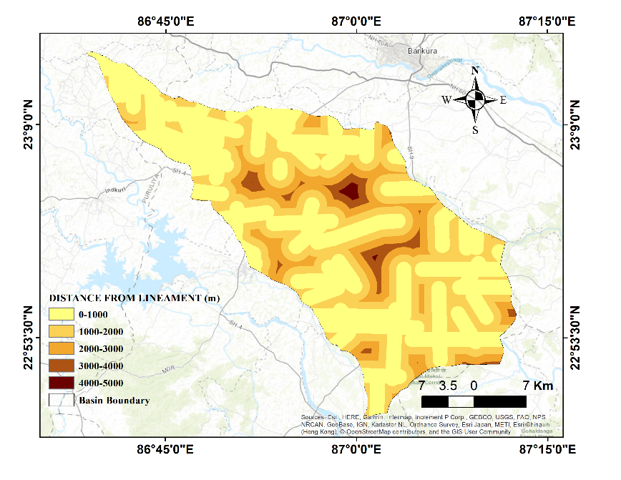
5. Distance from Lineaments
Lineaments mainly reflect the subsurface geology of a study area where some linear fracture zones are expected to exist.
Zones close to lineaments generally have good porosity and permeability.
Lineaments influence the movement and storage of groundwater. The area close to a lineament has good groundwater prospects.
From the maps, it has been observed that lineaments are closely located in the western and lower part of the basin.
Features/Class (Distance from lineaments in m) | GW Potential | Sub criteria Weight | Percentage Area
0-1000 | Very good | 0.333 | 52.28
1000-2000 | Good | 0.267 | 30.16
2000-3000 | Moderate | 0.200 | 13.77
3000-4000 | poor | 0.133 | 3.41
4000-5000 | Very poor | 0.067 | 0.37

Slide 30
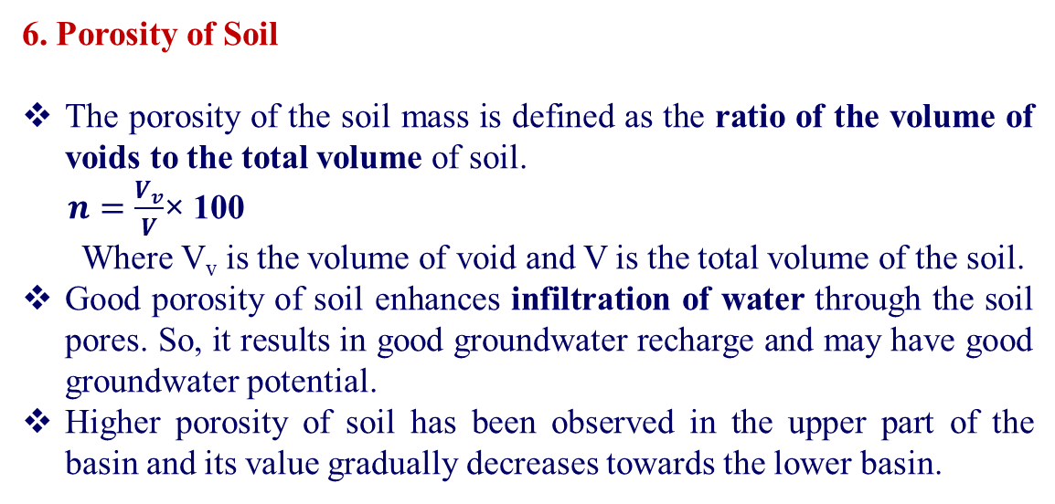
6. Porosity of Soil
The porosity of the soil mass is defined as the ratio of the volume of voids to the total volume of soil.
$n=\frac{V_{v}}{V}$× 100
Where V_{v} is the volume of void and V is the total volume of the soil.
Good porosity of soil enhances infiltration of water through the soil pores. So, it results in good groundwater recharge and may have good groundwater potential.
Higher porosity of soil has been observed in the upper part of the basin and its value gradually decreases towards the lower basin.
Porosity of soil samples determined in the laboratory by saturation method:
Village Name | Porosity, n (%)
Aralbara | 54.76
Bansidi | 57.58
Baragram | 39.39
Baromesya | 46.15
Bara Metala | 48.65
Dumuria | 51.16
Gharpathar | 53.49
Guniada | 76.67
Kantapal | 47.5
Kawabasa | 25.64
Kolaboti (Susunia) | 42.11
Kusumdunri | 48.84
Kharjuria | 40
Metyal | 47.5
Niasa | 48.89
Pachaparar | 30.3
Poradi | 47.62
Rampur | 45.83
Upar Maity Bandh | 52.63
Features/Class (Porosity, %) | GW Potential | Sub criteria Weight | Percentage Area
30.30-40.26 | Poor | 0.118 | 7.23
40.26-47.87 | Moderate | 0.176 | 44.59
47.87-53.66 | Moderate | 0.176 | 25.93
53.66-62.54 | Good | 0.235 | 18.69
62.54-76.30 | Very good | 0.294 | 3.56

Slide 31
Porosity map of the study area

Slide 32
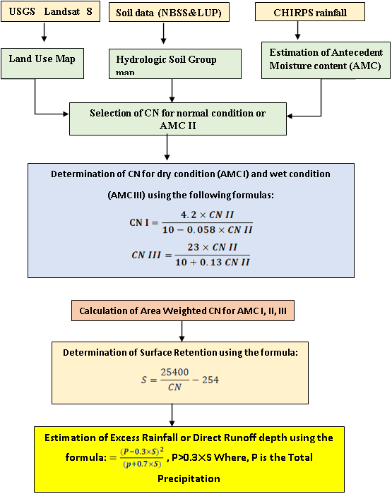
7. Runoff
Runoff calculation has been done using the SCS curve number method.
SCS curve number method estimates precipitation excess as a function of cumulative precipitation, soil type, land use and antecedent moisture content (AMC).
Runoff decreases the groundwater recharge. So it has an inverse relation with groundwater recharge.
Features/Class (Annual runoff depth in mm) | GW Potential | Sub criteria Weight | Percentage Area
1718.2 (Joypanda) | Moderate | 0.429 | 34.19
1758.7 (Silabati) | Good | 0.571 | 65.81

Slide 33
Runoff map of the study area

Slide 34
8. Rainfall
Important hydrological source of groundwater. Determines the fluctuations of subsurface water level from season to season.
The distribution of rainfall along with slope gradient has a major effect on the infiltration of runoff water.
Almost 72% of the total annual rainfall occurs in the monsoon season because of the southwest monsoon wind during the month from June to September.
Features/Class (Monthly avg. rainfall in mm) | GW Potential | Sub criteria Weight | Percentage Area
141.11-144.05 | Moderate | 0.150 | 11.52
144.05-146.55 | Moderate | 0.150 | 29.12
146.55-148.96 | Moderate | 0.150 | 36.40
148.96-151.30 | Good | 0.200 | 12.14
151.30-155.01 | Good | 0.200 | 10.82

Slide 35
9. Soil Class
Soil texture influences infiltration rate and therefore groundwater potential of a study area.
Sandy and gravelly soil have good infiltration capacity and hence good groundwater possibilities. Clayey soil has poor infiltration capacity and poor groundwater potential.
The soil map has been downloaded from the National Bureau of Soil Survey and Land Use Planning (NBSSLUP).
Features/Class (Soil Class) | GW Potential | Sub criteria Weight | Percentage Area
Fine | Poor | 0.095 | 24.17
Fine loamy to coarse loamy | Good | 0.190 | 6.60
Fine loamy | Moderate | 0.143 | 43.05
Gravelly loam | Good | 0.190 | 1.83
Fine loamy to sandy | Good | 0.190 | 16.69
Gravelly loam-loam | Good | 0.190 | 7.60

Slide 36
Features/Class (Distance from the wells having yield capacity 50-100 LPM), in m | GW Potential | Sub criteria Weight | Percentage Area
1000-2000 | Very good | 0.333 | 52.47
2000-4000 | Good | 0.267 | 33.83
4000-6000 | Moderate | 0.200 | 10.00
6000-8000 | Poor | 0.133 | 2.52
8000-11000 | Very poor | 0.067 | 1.18
10. Distance from wells
The existence of high-yield dug wells in a location is a good indication of excellent groundwater potential. So, areas close to the wells have good groundwater possibilities.
The wells with 50-100 LPM capacity have been digitized and the ‛Multiple Ring Buffer’ function of the Analysis Tool has been used to get the buffer map of the study area.
More high yield wells are observed in the middle portion of the basin.

Slide 37
11. Relative Relief
Higher relative relief of the study area encourages surface runoff and may cause poor groundwater potential. Hence, inverse relation with groundwater potential.
Relative relief of the study area has been calculated using Melton’s formula:
Relative relief, R=∆H/P
Where ∆H is the difference in elevations of the highest and the lowest points of an area and P is the perimeter of the basin.
Mainly western and middle portion of the basin has been observed with higher relative relief values.
Features/Class (Relative relief, in m) | GW Potential | Sub criteria Weight | Percentage Area
3.901-16.502 | Very Good | 0.333 | 17.57
16.502-20.899 | Good | 0.267 | 43.91
20.89-26.219 | Moderate | 0.200 | 31.45
26.219-43.927 | Poor | 0.133 | 5.86
43.927-83.206 | Very poor | 0.067 | 0.49

Slide 38
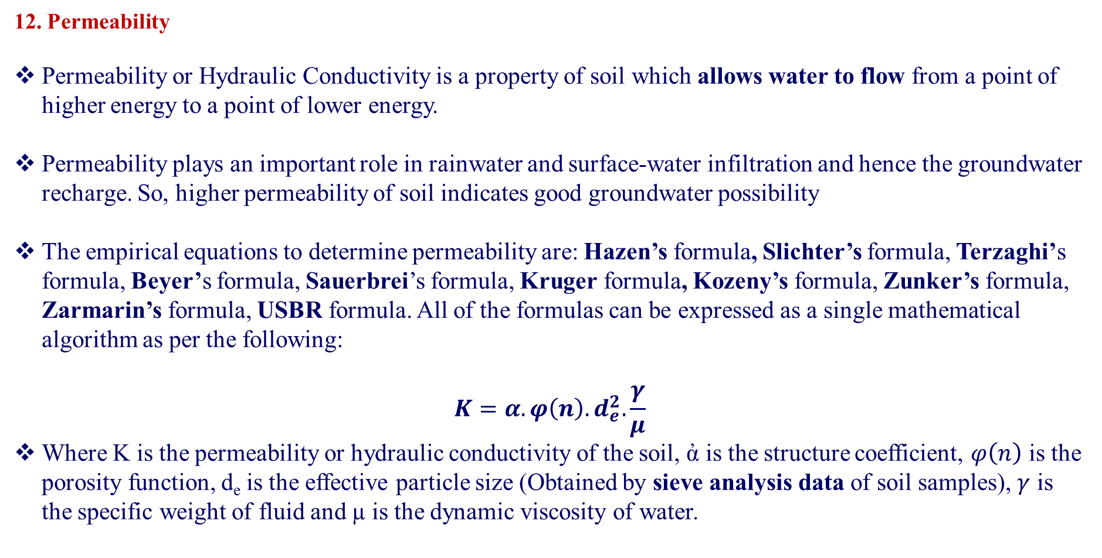
12. Permeability
Permeability or Hydraulic Conductivity is a property of soil which allows water to flow from a point of higher energy to a point of lower energy.
Permeability plays an important role in rainwater and surface-water infiltration and hence the groundwater recharge. So, higher permeability of soil indicates good groundwater possibility
The empirical equations to determine permeability are: Hazen’s formula, Slichter’s formula, Terzaghi’s formula, Beyer’s formula, Sauerbrei’s formula, Kruger formula, Kozeny’s formula, Zunker’s formula, Zarmarin’s formula, USBR formula. All of the formulas can be expressed as a single mathematical algorithm as per the following:
$$K=α.φ\left(n\right).d_{e}^{2}.\frac{γ}{μ}$$
Where K is the permeability or hydraulic conductivity of the soil, ἀ is the structure coefficient, $φ\left(n\right)$ is the porosity function, d_{e} is the effective particle size (Obtained by sieve analysis data of soil samples), $γ$ is the specific weight of fluid and µ is the dynamic viscosity of water.

Slide 39
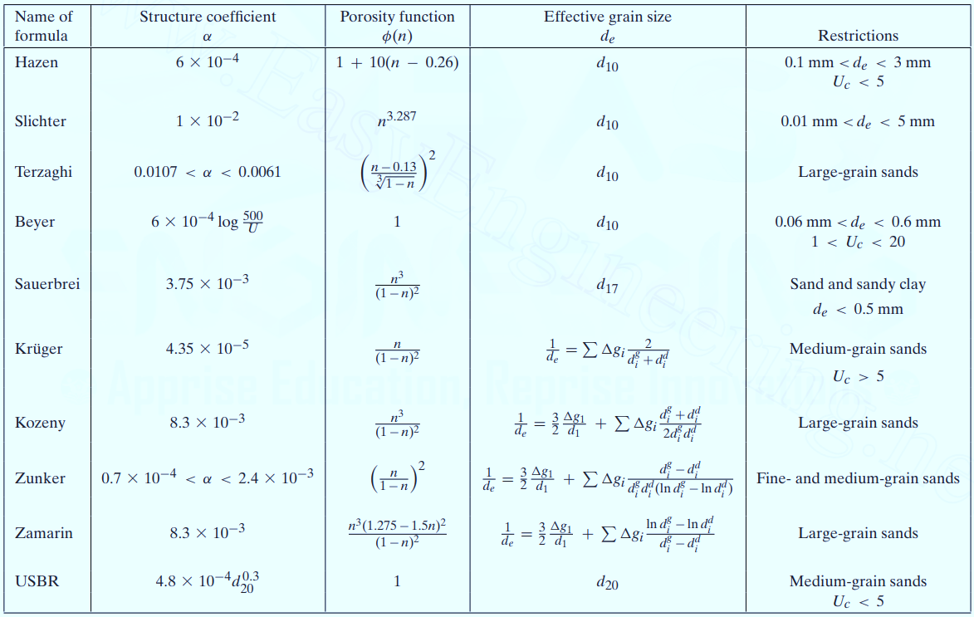
Empirical Equations for Permeability Calculations

Slide 40
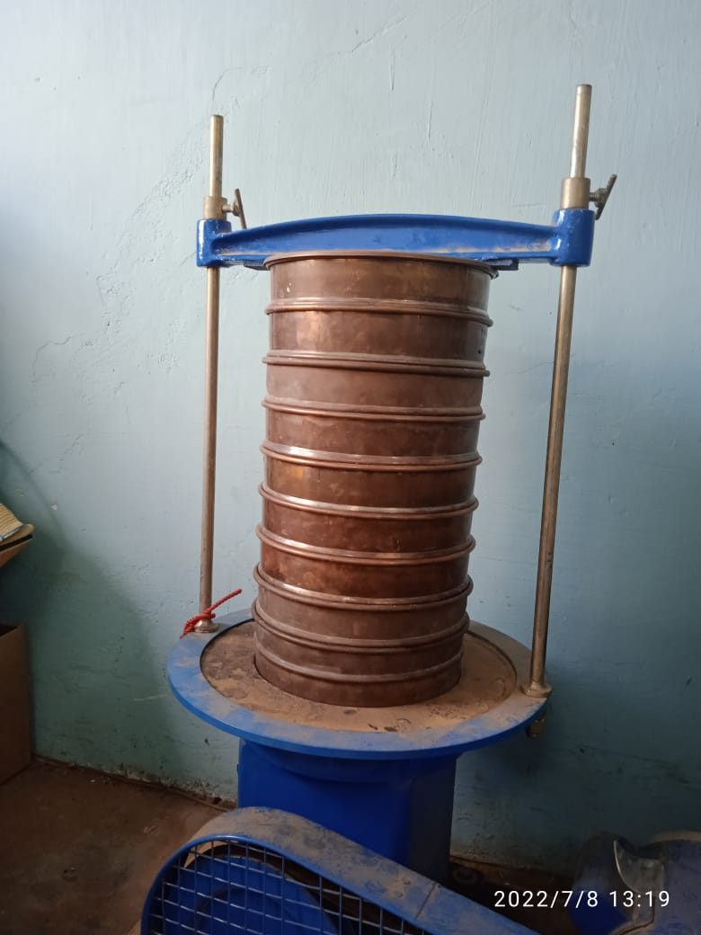
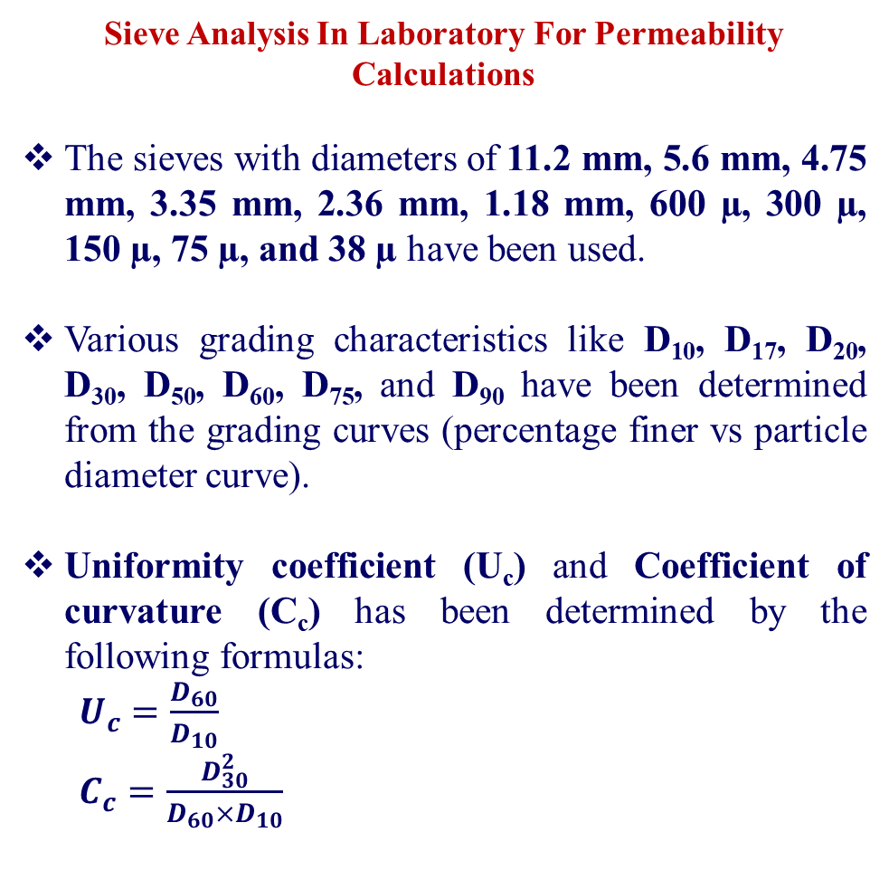
Sieve Analysis In Laboratory For Permeability Calculations
The sieves with diameters of 11.2 mm, 5.6 mm, 4.75 mm, 3.35 mm, 2.36 mm, 1.18 mm, 600 µ, 300 µ, 150 µ, 75 µ, and 38 µ have been used.
Various grading characteristics like D₁₀, D₁₇, D₂₀, D₃₀, D₅₀, D₆₀, D₇₅, and D₉₀ have been determined from the grading curves (percentage finer vs particle diameter curve).
Uniformity coefficient (U_{c}) and Coefficient of curvature (C_{c}) has been determined by the following formulas:
$U_{c}=\frac{D_{60}}{D_{10}}$
$C_{c}=\frac{D_{30}^{2}}{D_{60}{×D}_{10}}$
Setup of Mechanical Sieve Shaker in Laboratory

Slide 41
Soil classification according to their grain size IS: 1498-1970
Cobble
(80-300 mm)
Gravel
Sand
Silt (0.075-0.002 mm)
Clay (<0.002 mm)
Coarse (20-80 mm)
Fine (4.75-20 mm)
Coarse (2-4.75 mm)
Medium (0.425-2 mm)
Fine (0.075-2 mm)

Slide 42

Gradation Characteristics of the soil samples
Village Name | Soil type | %Silt | %Sand | %Gravel | D₁₀ | D₁₇ | D₂₀ | D₃₀ | D₅₀ | D₆₀ | D₇₅ | D₉₀ | Uniformity Coefficient | Coefficient of Curvature
Aralbara | SP | 1.71 | 97.43 | 0.86 | 0.11 | 0.13 | 0.15 | 0.21 | 0.34 | 0.42 | 0.53 | 1.18 | 3.89 | 0.95
Bansidi | SW-SM | 3.00 | 71.80 | 25.20 | 0.13 | 0.29 | 0.35 | 0.57 | 1.72 | 2.23 | 4.76 | 6.67 | 16.54 | 1.07
Barogram | SW-SM | 0.40 | 97.60 | 2.00 | 0.17 | 0.28 | 0.31 | 0.38 | 0.52 | 0.59 | 1.31 | 2.19 | 3.37 | 1.41
Bara Metala | SM | 12.67 | 86.67 | 0.67 | 0.06 | 0.08 | 0.09 | 0.10 | 0.13 | 0.14 | 0.31 | 1.21 | 2.17 | 1.07
Dumuria | SW | 3.50 | 91.50 | 5.00 | 0.10 | 0.13 | 0.14 | 0.22 | 0.47 | 0.65 | 1.60 | 3.75 | 6.45 | 0.74
Guniada | SP-SM | 6.50 | 61.50 | 32.00 | 0.03 | 0.27 | 0.36 | 1.03 | 2.24 | 3.98 | 5.10 | 8.55 | 119.33 | 7.98
Kantapal | SP-SM | 6.40 | 90.60 | 3.00 | 0.08 | 0.10 | 0.11 | 0.13 | 0.27 | 0.42 | 0.93 | 2.17 | 5.05 | 0.48
Kawabasa | SP-SM | 0.33 | 94.17 | 5.50 | 0.23 | 0.32 | 0.35 | 0.43 | 0.59 | 1.10 | 1.86 | 3.99 | 4.86 | 0.74
Kolaboti (Susunia) | SP | 0.33 | 86.00 | 13.67 | 0.30 | 0.40 | 0.45 | 0.59 | 1.71 | 2.11 | 3.87 | 5.08 | 6.94 | 0.53
Kusumdunri | SP | 0.80 | 94.60 | 4.60 | 0.15 | 0.21 | 0.24 | 0.33 | 0.50 | 0.59 | 1.54 | 3.60 | 4.04 | 1.28
Kharjuria | SP | 3.71 | 75.43 | 20.86 | 0.12 | 0.20 | 0.26 | 0.42 | 1.20 | 1.78 | 4.03 | 11.56 | 14.72 | 0.84
Metyal | SP | 2.75 | 72.00 | 25.25 | 0.10 | 0.13 | 0.14 | 0.26 | 1.01 | 1.88 | 4.77 | 8.13 | 18.37 | 0.35
Niasa | SP-SM | 7.20 | 88.60 | 9.60 | 0.16 | 0.31 | 0.36 | 0.51 | 1.26 | 1.65 | 2.23 | 4.70 | 10.12 | 0.98
Pachaparar | SP-SM | 7.20 | 89.00 | 3.80 | 0.09 | 0.12 | 0.13 | 0.19 | 0.35 | 0.45 | 0.60 | 2.08 | 5.15 | 0.89
Poradi | GW | 1.38 | 34.25 | 64.38 | 0.24 | 0.53 | 0.82 | 2.31 | 9.21 | 12.88 |  |  | 52.98 | 1.70
Rampur | SP-SM | 5.25 | 92.25 | 2.50 | 0.09 | 0.12 | 0.13 | 0.20 | 0.44 | 0.57 | 1.44 | 2.61 | 6.11 | 0.77
Upar Maity Bandh | SW | 1.75 | 66.50 | 31.75 | 0.20 | 0.45 | 0.55 | 1.26 | 2.14 | 3.81 | 5.08 | 7.72 | 18.70 | 2.04

Slide 43
Permeability values by different empirical formulas
**Green coloured numbers represents the permeability values of those soils for which empirical equations are applicable. Red coloured values are rejected. The average of green coloured values give the final permeability.

Slide 44
Average permeability values of the soil samples
Features/Class | GW Potential | Sub criteria Weight | Percentage Area
4.284-28.776 | Very poor | 0.077 | 20.69
28.776-49.458 | Poor | 0.154 | 44.18
49.458-73.949 | Moderate | 0.231 | 16.66
73.949-102.795 | Moderate | 0.231 | 14.18
102.795-143.071 | Good | 0.308 | 4.29
Site Name | Average Permeability (m/day)
Aralbara | 36.83
Bansidi | 106.47
Barogram | 37.89
Baromesya | 40.04
Bara Metala | 7.15
Dumuria | 21.48
Guniada | 6.17
Kantapal | 9.12
Kawabasa | 25.93
Kolaboti | 81.94
Kusumdunri | 48.03
Kharjuria | 13.62
Metyal | 11.94
Niasa | 11.94
Pachaparar | 3.74
Poradi | 60.40
Rampur | 16.38
Upar Maity Bandh | 143.07

Slide 45
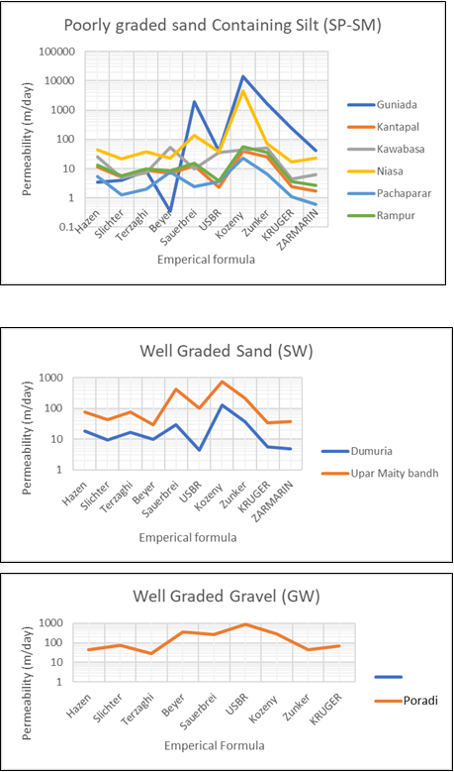
Comparison of Permeability values by different empirical formulas for different soil types
Here, ‘Permeability Vs Empirical Formula’ graphs have been shown for different soil classes (according to their grain characteristics).
It can be realized that a particular type of soil shows almost the same curve pattern.
So, it can be concluded that the consistency level of permeability calculations was good enough.

Slide 46
13. Slope
A flat slope encourages higher infiltration and more groundwater recharge and a steep slope causes higher runoff and inhibits groundwater recharge.
The slope has an inverse relationship with groundwater potential, slope class with a lower value has been assigned a higher weight.
The slope map has been prepared using SRTM DEM of 30 m resolution by the Slope function of the spatial analyst tool in ArcGIS software.
From the slope map, it is obvious that the upper and upper-middle portions of the basin have higher slope values.
Features/Class (Slope in degrees) | GW Potential | Sub criteria Weight | Percentage Area
0.338-1.726 | Very Good | 0.333 | 22.10
1.726-3.209 | Good | 0.267 | 34.39
3.209-5.285 | Moderate | 0.200 | 29.47
5.285-9.793 | Poor | 0.133 | 13.71
9.793-36.310 | Very poor | 0.067 | 0.14

Slide 47
Site Name | Water Holding Capacity (%)
Aralbara | 49.008
Bansidi | 53.976
Barogram | 51.948
Baromesya | 56.872
Bara Metala | 59.675
Dumuria | 42.344
Guniada | 49.573
Kantapal | 54.054
Kawabasa | 67.743
Kolaboti | 48.621
Kusumdunri | 76.663
Kharjuria | 53.451
Metyal | 34.160
Niasa | 59.926
Pachaparar | 34.272
Poradi | 43.606
Rampur | 51.086
Upar Maity Bandh | 60.689
14. Water Holding Capacity
The water holding capacity of the soil can be defined as the amount of water retained per unit mass of soil.
Groundwater potential has an inverse relationship with water holding capacity.
The water holding capacity data found in the laboratory has been exported in the ArcGIS software and a raster map has been prepared with Inverse Distance Weighted (IDW) interpolation.
Features/Class (Water Holding Capacity, %) | GW Potential | Sub criteria Weight | Percentage Area
34.437-45.531 | Very Good | 0.333 | 5.67
45.531-51.658 | Good | 0.267 | 27.48
51.658-55.798 | Moderate | 0.200 | 45.31
55.798-63.415 | Poor | 0.133 | 17.86
63.415-76.331 | Very poor | 0.067 | 3.68

Slide 48
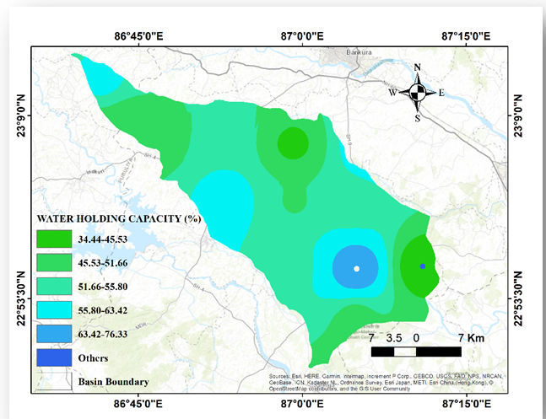
Water holding capacity map of the study area

Slide 49
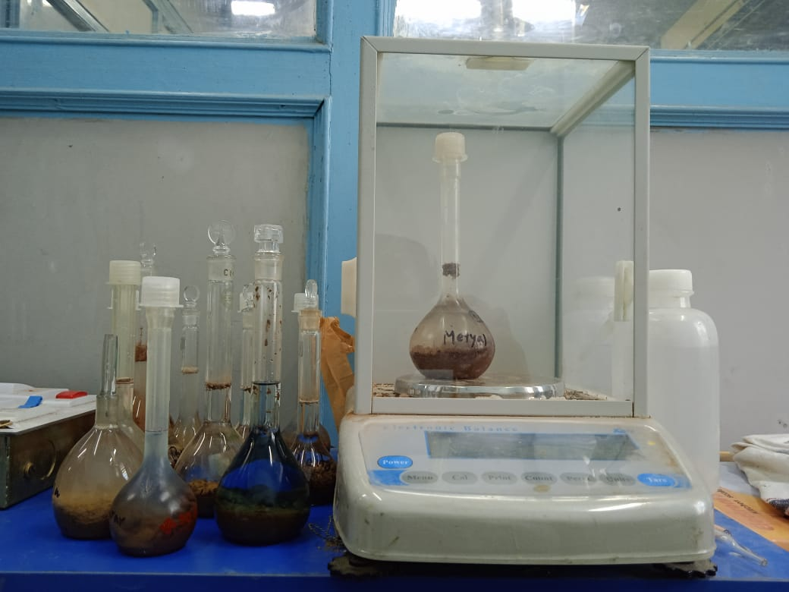
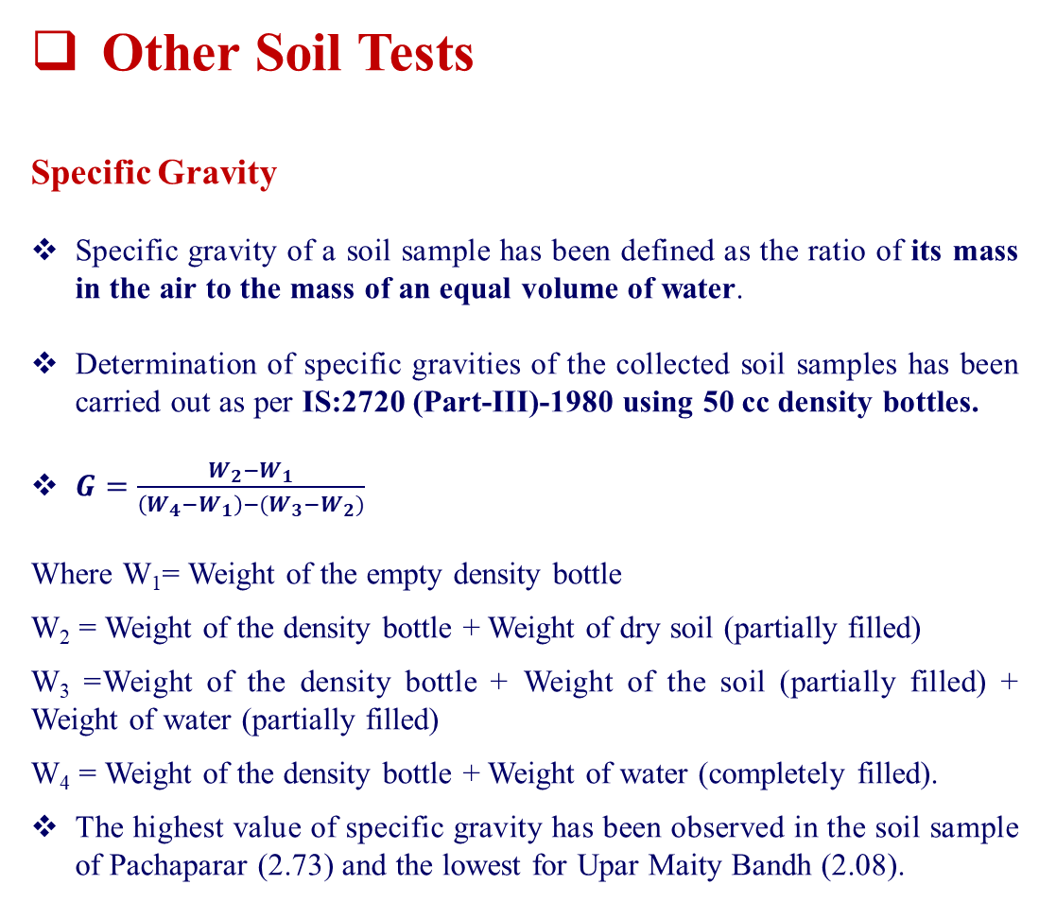
Other Soil Tests
Specific Gravity
Specific gravity of a soil sample has been defined as the ratio of its mass in the air to the mass of an equal volume of water.
Determination of specific gravities of the collected soil samples has been carried out as per IS:2720 (Part-III)-1980 using 50 cc density bottles.
$G=\frac{W_{2}−W_{1}}{\left(W_{4}−W_{1}\right)−(W_{3}−W_{2})}$
Where W₁= Weight of the empty density bottle
W₂ = Weight of the density bottle + Weight of dry soil (partially filled)
W₃ =Weight of the density bottle + Weight of the soil (partially filled) + Weight of water (partially filled)
W₄ = Weight of the density bottle + Weight of water (completely filled).
The highest value of specific gravity has been observed in the soil sample of Pachaparar (2.73) and the lowest for Upar Maity Bandh (2.08).
Specific gravity test setup in the laboratory

Slide 50
Grain-specific gravity of the soil samples
Site Name | Specific Gravity
 | W₁ (g) | W₂ (g) | W₃ (g) | W₄ (g) | G
Aralbara | 40.23 | 52.18 | 96.72 | 90.11 | 2.24
Bansidi | 42.73 | 79.38 | 112.23 | 92.34 | 2.19
Barogram | 46.07 | 67.28 | 108.35 | 95.59 | 2.51
Baromesya | 13.24 | 37.93 | 76.69 | 63.45 | 2.16
Bara Metala | 47.84 | 65.60 | 107.80 | 97.67 | 2.33
Dumuria | 13.26 | 35.50 | 75.88 | 63.32 | 2.30
Gharpathar | 47.92 | 73.15 | 111.99 | 97.20 | 2.42
Guniada | 69.29 | 108.34 | 192.00 | 168.35 | 2.54
Kantapal | 39.94 | 55.38 | 94.50 | 85.64 | 2.35
Kawabasa | 41.50 | 64.07 | 104.41 | 92.18 | 2.18
Kolaboti (Susunia) | 22.15 | 55.49 | 142.39 | 122.06 | 2.56
Kusumdunri | 45.89 | 70.23 | 100.92 | 85.03 | 2.25
Kharjuria | 13.84 | 37.59 | 77.33 | 63.97 | 2.29
Metyal | 20.94 | 78.67 | 155.51 | 121.09 | 2.48
Niasa | 41.29 | 73.07 | 157.03 | 139.87 | 2.17
Pachaparar | 13.78 | 47.61 | 77.04 | 52.92 | 2.73
Poradi | 43.47 | 69.46 | 108.10 | 93.06 | 2.38
Rampur | 46.56 | 69.87 | 110.31 | 96.18 | 2.54
Upar Maity Bandh | 47.53 | 66.88 | 107.08 | 97.05 | 2.08

Slide 51
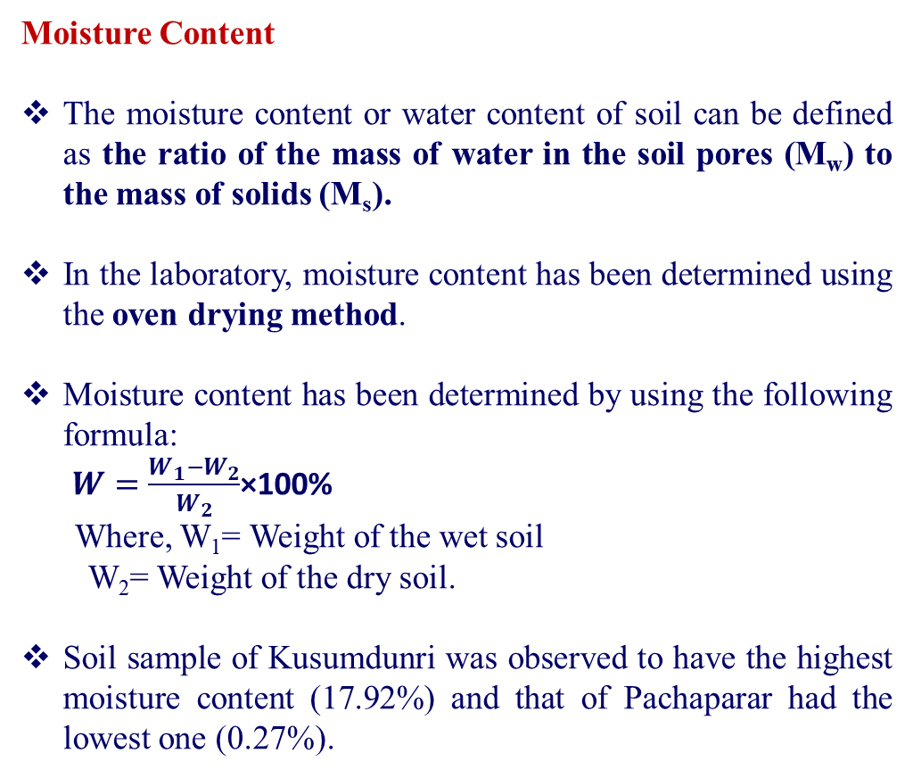
Moisture Content
The moisture content or water content of soil can be defined as the ratio of the mass of water in the soil pores (M_{w}) to the mass of solids (M_{s}).
In the laboratory, moisture content has been determined using the oven drying method.
Moisture content has been determined by using the following formula:
$W=\frac{W_{1}−W_{2}}{W_{2}}$×100%
Where, W₁= Weight of the wet soil
W₂= Weight of the dry soil.
Soil sample of Kusumdunri was observed to have the highest moisture content (17.92%) and that of Pachaparar had the lowest one (0.27%).
Site Name | Moisture Content (%)
Aralbara | 10.45
Bansidi | 14.78
Barogram | 13.23
Baromesya | 2.22
Bara Metala | 7.92
Dumuria | 2.84
Gharpathar | 10.23
Guniada | 3.75
Kantapal | 6.56
Kawabasa | 5.11
Kolaboti (Susunia) | 4.78
Kusumdunri | 17.92
Kharjuria | 2.77
Metyal | 1.46
Niasa | 8.29
Pachaparar | 0.27
Poradi | 2.85
Rampur | 8.10
Upar Maity Bandh | 12.36

Slide 52
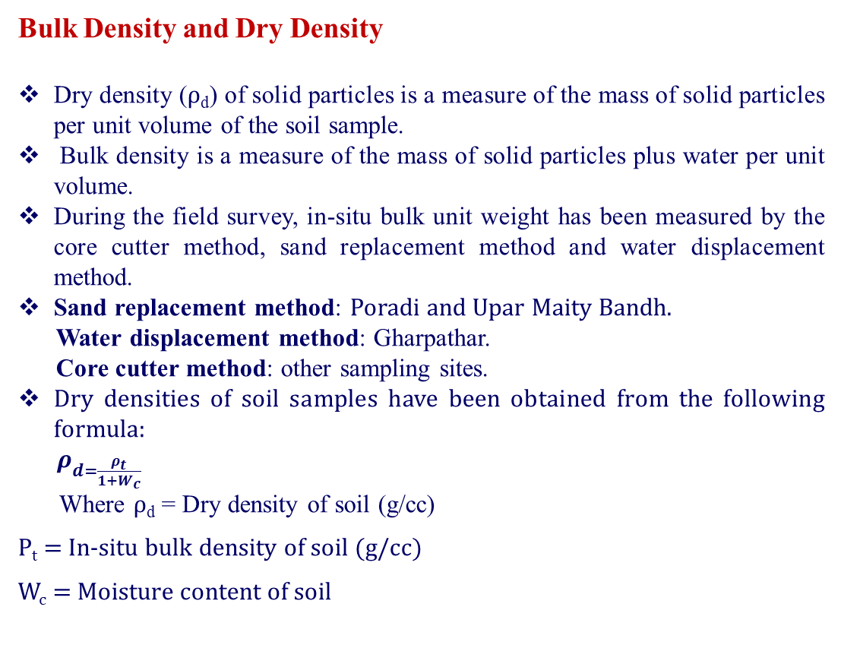
Bulk Density and Dry Density
Dry density (ρ_{d}) of solid particles is a measure of the mass of solid particles per unit volume of the soil sample.
Bulk density is a measure of the mass of solid particles plus water per unit volume.
During the field survey, in-situ bulk unit weight has been measured by the core cutter method, sand replacement method and water displacement method.
Sand replacement method: Poradi and Upar Maity Bandh.
Water displacement method: Gharpathar.
Core cutter method: other sampling sites.
Dry densities of soil samples have been obtained from the following formula:
$ρ_{d=\frac{ρ_{t}}{1+W_{c}}}$
Where ρ_{d} = Dry density of soil (g/cc)
Ρ_{t} = In-situ bulk density of soil (g/cc)
W_{c} = Moisture content of soil
Site Names | Bulk Density (g/cc) | Dry density (g/cc)
Aralbara | 1.42 | 1.28
Bansidi | 1.50 | 1.31
Barogram | 1.54 | 1.36
Baromesya | 1.46 | 1.42
Bara Metala | 1.59 | 1.47
Dumuria | 1.43 | 1.39
Gharpathar | 1.94 | 1.76
Guniada | 1.39 | 1.34
Kantapal | 1.61 | 1.51
Kawabasa | 1.51 | 1.43
Kolaboti (Susunia) | 1.66 | 1.59
Kusumdunri | 1.72 | 1.45
Kharjuria | 1.41 | 1.37
Metyal | 1.64 | 1.62
Niasa | 1.32 | 1.22
Pachaparar | 1.67 | 1.67
Poradi | 1.54 | 1.50
Rampur | 1.81 | 1.68
Upar Maity Bandh | 1.29 | 1.15

Slide 53
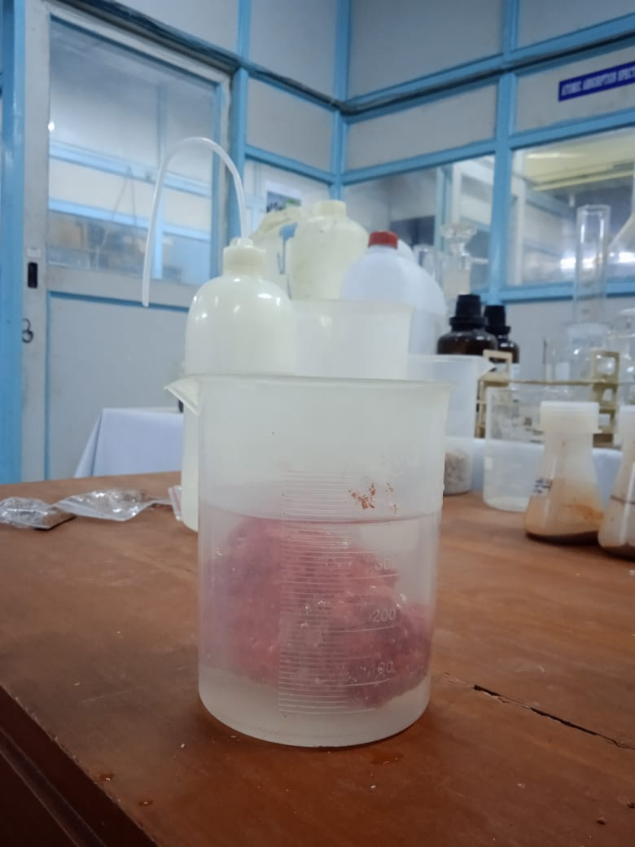
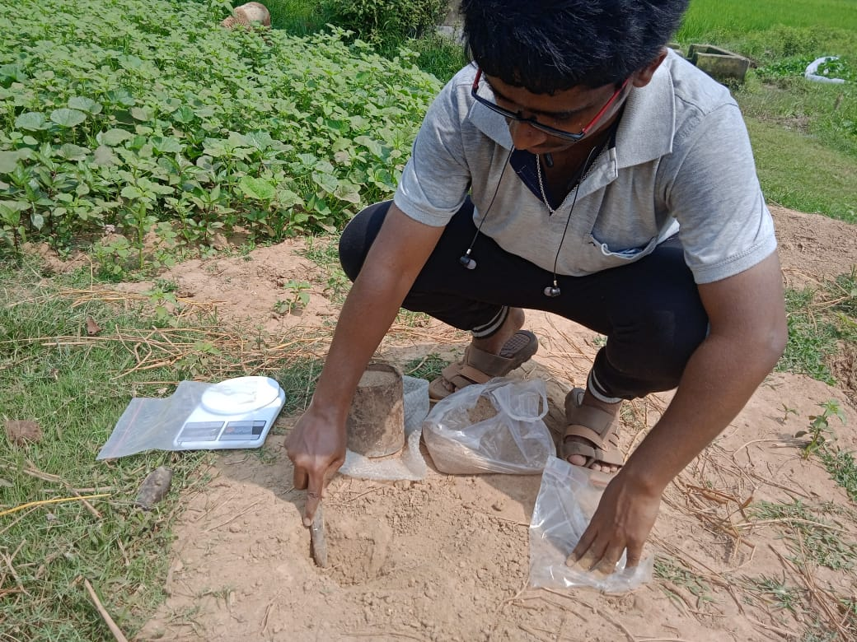
In-situ Bulk Density determination by Core cutter method
Bulk density determination in laboratory by water displacement method

Slide 54
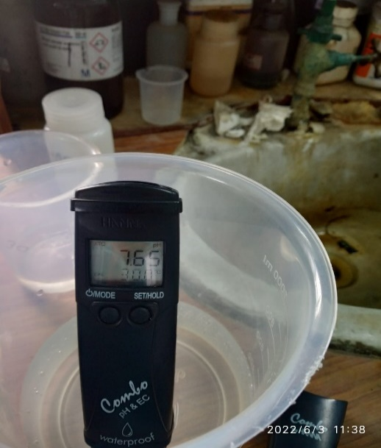
Laboratory Test Procedures of Water Quality Parameters
pH
pH value denotes whether the water is acidic or alkaline.
pH value greater than 7 indicates alkaline water and pH value less than 7 indicates acidic solution.
2. Total Dissolved Solid
Total dissolved solids (TDS) mean the portion of total solids that passes through filter media after the removal of suspended solids.
Generally, particles having size less than 0.5 to 2 micron characterized as dissolved solid.
3. Electrical Conductivity
Electrical conductivity of water is a measure to check how easily electric current passes through it.
Its value directly depends on the number of ions or electrolytes present in the water.
TDS, pH, EC all of these three parameters has been measured at the field level using ‘combined pH and EC probe made by HANNA’
Probe to measure pH, EC and TDS

Slide 55
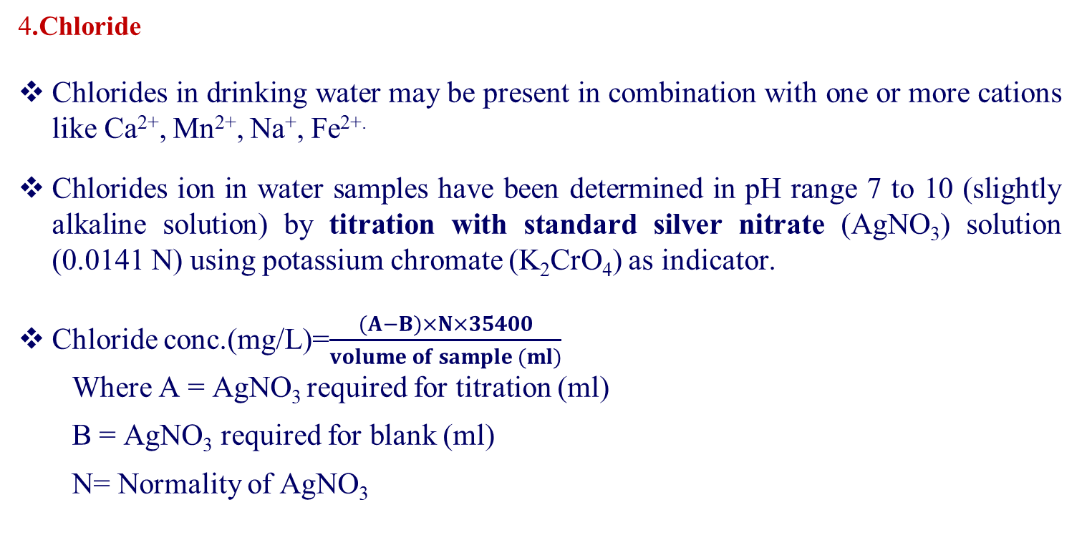
4.Chloride
Chlorides in drinking water may be present in combination with one or more cations like Ca²⁺, Mn²⁺, Na⁺, Fe^{2+.}
Chlorides ion in water samples have been determined in pH range 7 to 10 (slightly alkaline solution) by titration with standard silver nitrate (AgNO₃) solution (0.0141 N) using potassium chromate (K₂CrO₄) as indicator.
Chloride conc.(mg/L)=$\frac{(A−B)×N×35400}{volume of sample (ml)}$
Where A = AgNO₃ required for titration (ml)
B = AgNO₃ required for blank (ml)
N= Normality of AgNO₃

Slide 56
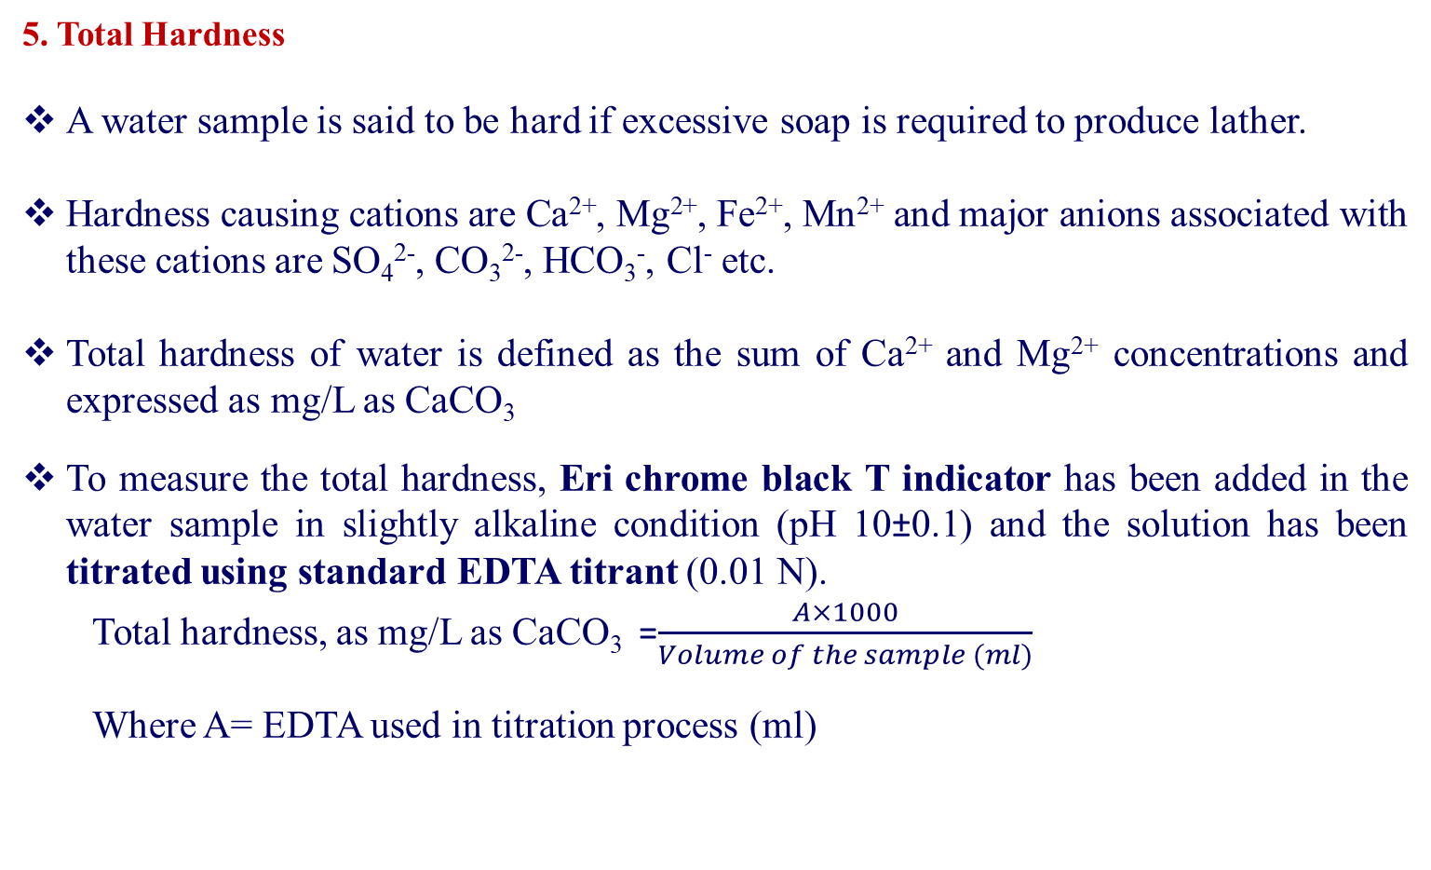
5. Total Hardness
A water sample is said to be hard if excessive soap is required to produce lather.
Hardness causing cations are Ca²⁺, Mg²⁺, Fe²⁺, Mn²⁺ and major anions associated with these cations are SO₄²⁻, CO₃²⁻, HCO₃⁻, Cl⁻ etc.
Total hardness of water is defined as the sum of Ca²⁺ and Mg²⁺ concentrations and expressed as mg/L as CaCO₃
To measure the total hardness, Eri chrome black T indicator has been added in the water sample in slightly alkaline condition (pH 10±0.1) and the solution has been titrated using standard EDTA titrant (0.01 N).
Total hardness, as mg/L as CaCO₃ =$\frac{A×1000}{Volume of the sample (ml)}$
Where A= EDTA used in titration process (ml)

Slide 57
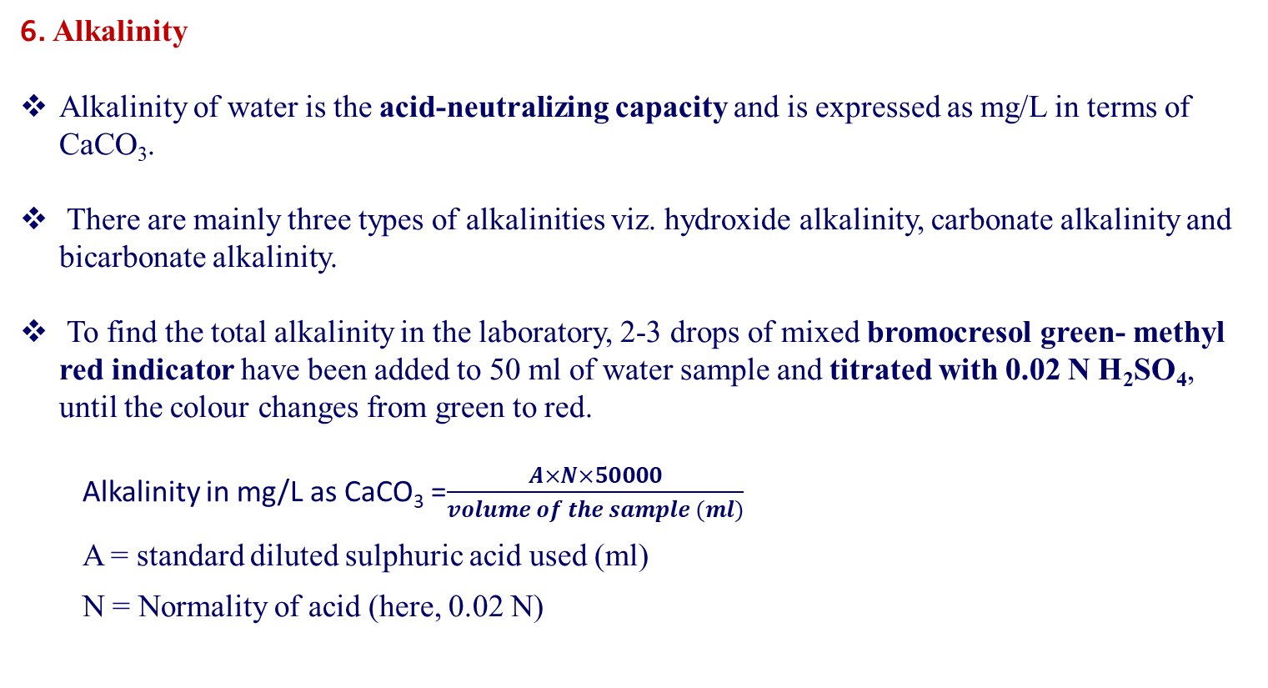
6. Alkalinity
Alkalinity of water is the acid-neutralizing capacity and is expressed as mg/L in terms of CaCO₃.
There are mainly three types of alkalinities viz. hydroxide alkalinity, carbonate alkalinity and bicarbonate alkalinity.
To find the total alkalinity in the laboratory, 2-3 drops of mixed bromocresol green- methyl red indicator have been added to 50 ml of water sample and titrated with 0.02 N H₂SO₄, until the colour changes from green to red.
Alkalinity in mg/L as CaCO₃ =$\frac{A×N×50000}{volume of the sample (ml)}$
A = standard diluted sulphuric acid used (ml)
N = Normality of acid (here, 0.02 N)

Slide 58
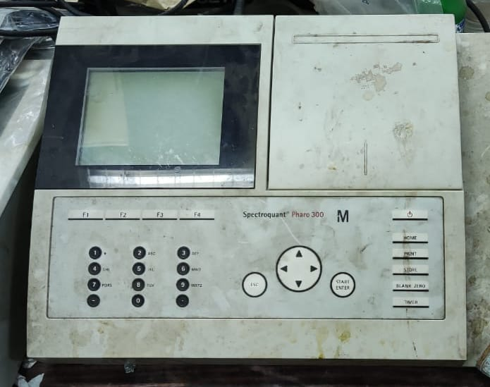
7. Iron
Iron can cause bad taste to water, causes discolouration to clothes and causes coating to the pipes.
During the sample collection, 2 ml of conc. hydrochloric acid was added in 100 ml of sample water and collected in a separate container to prevent the oxidation of ferrous ion.
In the laboratory, ‘FerroVer Iron Reagent Powder Pillow, Hach India’ has been added to 10 ml sample in a glass container
The concentration of iron has been determined by spectrophotometer (model- Spectroquant Pharo 300). It measures the colour intensity at 510 nm wavelength.
Spectroquant Pharo 300

Slide 59
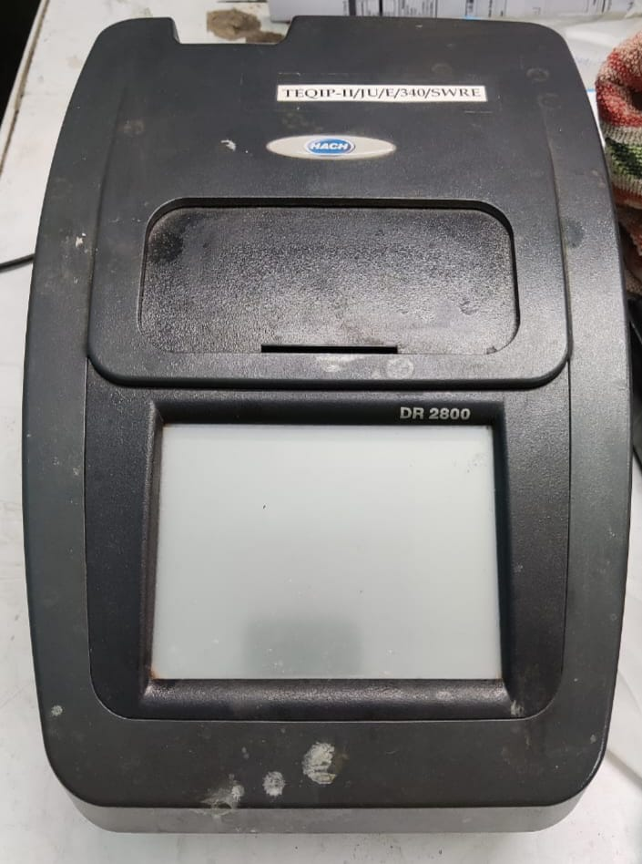
8. Sulphate, Phosphate and Nitrates
These three tests have been carried out in laboratory using a spectrophotometer (model- DR 2800, by HACH).
Sulphate and been measured at 420 nm wavelength. Nitrate has been identified at 220 nm and 275 nm wavelengths.
Water parameters | Name of pillow powders
Sulphate | SulfaVer® 4 Sulfate Reagent Powder Pillows, HACH India
Phosphate | PhosVer 3 Phosphate Reagent powder Pillows, HACH UK
Nitrate | NitraVer® 5 Nitrate Reagent Powder Pillows, HACH USA
spectrophotometer (model- DR 2800, by HACH).
Pillow powders used to measure SO₄²⁻ , PO₄³⁻ , NO₃⁻

Slide 60
Drinking water quality standards as per IS 10500:2012
Water quality | Acceptable limit | Permissible limit
pH | 6.5-8.5 | No relaxation
Total Dissolved Solids (mg/L) | 500 | 2000
Electrical Conductivity* (µS/cm) | 400 | …
Chloride (mg/L) | 250 | 1000
Total Hardness (mg/L as CaCO3) | 200 | 600
Total Alkalinity (mg/L as CaCO3) | 200 | 600
Iron (mg/L) | 1 | No relaxation
Sulphate (mg/L) | 200 | 400
Phosphate (mg/L) | 1 | …
Nitrate (mg/L) | 45 | No relaxation
*WHO standard

Slide 61
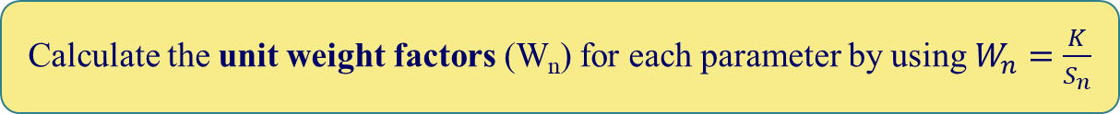
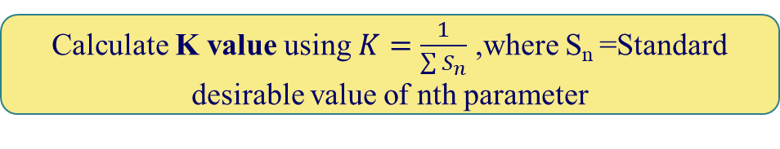
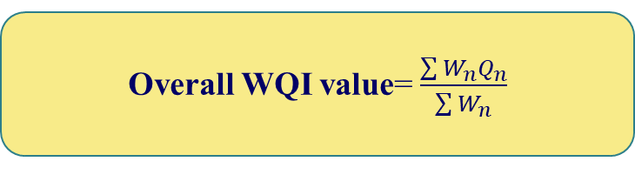

Water Quality Index by Weighted Arithmetic Index Method or Brown’s Method
Calculate K value using $K=\frac{1}{\sum{S_{n}}}$ ,where S_{n} =Standard desirable value of nth parameter
Calculate the unit weight factors (W_{n}) for each parameter by using $W_{n}=\frac{K}{S_{n}}$
Calculate Sub-index value by using, $Q_{n}=\left(\frac{V_{n}−V_{0}}{S_{n}−V_{0}}\right)×100$
V_{n} =Mean conc. of nth parameter, V₀=Actual value of the parameter in pure water
Overall WQI value= $\frac{\sum{W_{n}Q_{n}}}{\sum{W_{n}}}$

Slide 62


Concepts of Validation Processes
VES SURVEY
The model was validated using the resistivity survey data from five different sites of the basin.
The Curve matching operation of resistivity survey data has been done by IPI2win software.
Instruments used for conducting the vertical electrical sounding survey were a resistivity meter (MODEL-SSR-MP1), two potential electrodes, two current electrodes, wires and wire holders.
.
The VES survey has been carried out by Schlumberger arrangement with a maximum current electrode spacing of 300 m.
Vertical Electrical Sounding field Survey

Slide 63

Direction of current flow lines and equipotential lines in Schumberger arrangement

Slide 64

Apparent resistivity, $ρ_{a}=\frac{π×\left\{{(\frac{L}{2})}^{2 }−{(\frac{b}{2})}^{2}\right\}}{b}×R$
Where R is the resistance of layer in ohm obtained from resistivity survey
Distance between potential electrodes (MN) = b
Distance between current electrodes (AB) = L
Schumberger’s arrangement gives a better result when L≥5b.
Dar- Zarrouk parameters i.e., longitudinal conductance (S) and transverse resistance (T) has been estimated by using the following formulas:
S=$\frac{h}{ρ_{a}}$ in Ω⁻¹
T= h. $ρ_{a}$ in Ω.m².
Relation between longitudinal conductance vs protective capacity:
Longitudinal Conductance (Ω⁻¹) | >10 | 5-10 | 0.7-4.9 | 0.2-0.69 | 0.1-0.19 | <0.1
Rating of protective capacity | Excellent | Very good | Good | Moderate | Weak | Poor

Slide 65
Results and Discussions
Delineation of Groundwater Potential Zone
The groundwater potential zone map has been obtained by integrating all the thematic layers using weighted overlay tool in ArcGIS.
The groundwater potential index varies from 1.37 to 4.17.
The study area can be classified in five different classes based on groundwater potential index i.e., very low (1.37-2.14), low (2.14-2.44), moderate (2.44-2.72), high (2.72-3.30) and very high (3.30-4.17).
Percentage area for each potential class for Silabati and Joypanda basin

Slide 66
Water Quality Assessment
Village Name | pH | TDS | EC | Chloride | Total Hardness | Alkalinity | Iron | Sulphate | Phosphate | Nitrate | WQI | quality
Aralbara | 6.98 | 296 | 560 | 113.88 | 596 | 380 | 3.62 | 85 | 0.15 | 8.6 | 176.1 | Unfit
Bansidi | 7.65 | 264 | 555 | 36.868 | 172 | 100 | 0.66 | 14 | 0.13 | 0 | 39.4 | Good
Baragram | 7.24 | 280 | 610 | 25.524 | 168 | 172 | 1.11 | 10 | 0.16 | 0 | 60.2 | poor
Baramesya | 6.32 | 75 | 150 | 11.344 | 100 | 48 | 2.38 | 7 | 0.17 | 2 | 120.6 | unfit
Bara Metala | 6.93 | 168 | 333 | 39.704 | 320 | 72 | 0.88 | 7 | 0.12 | 0 | 47.1 | Good
Dumuria | 6.3 | 210 | 419 | 25 | 184 | 160 | 1.9 | 2 | 0.3 | 0.5 | 104.8 | Unfit
Gharpathar | 6.51 | 150 | 311 | 90.752 | 188 | 88 | 1.22 | 21 | 0.1 | 0 | 63.3 | Poor
Guniada | 7.89 | 376 | 740 | 45.376 | 200 | 220 | 1.22 | 4 | 0.1 | 0 | 65.0 | Poor
Kantapal | 5.92 | 186 | 375 | 39.5 | 108 | 220 | 2.4 | 11 | 0.01 | 1.2 | 115.9 | Unfit
Kawabasa | 5.51 | 28 | 56 | 11.344 | 20 | 28 | 0.54 | 0 | 0 | 1 | 30.5 | Good
Kolaboti | 5.91 | 162 | 193 | 5.7 | 104 | 30 | 0.1 | 5 | 0.06 | 3.9 | 11.7 | Excellent
Kusumdunri | 5.88 | 53 | 105 | 11.344 | 28 | 20 | 3.21 | 1 | 0.07 | 3 | 155.8 | Unfit
Kharjuria | 6.59 | 197 | 388 | 14.18 | 136 | 116 | 5 | 17 | 0.19 | 21 | 242.3 | Unfit
Metyal | 5.09 | 159 | 317 | 51 | 84 | 20 | 0.56 | 1 | 0.01 | 5.6 | 33.7 | Good
Niasa | 7.11 | 864 | 1735 | 221.208 | 88 | 256 | 0.36 | 91 | 0.71 | 11 | 51.4 | Poor
Pachaparar | 5.65 | 6 | 16 | 8.508 | 32 | 24 | 0.16 | 0 | 0.19 | 0 | 21.1 | Excellent
Poradi | 7.54 | 166 | 340 | 22.688 | 152 | 100 | 0.49 | 0 | 0.07 | 1 | 28.3 | Good
Rampur | 6.61 | 418 | 653 | 57.98 | 308 | 180 | 1.19 | 54 | 0.08 | 3 | 61.1 | Poor
Upar Maity Bandh | 6.89 | 513 | 1023 | 110.604 | 308 | 188 | 0.48 | 39 | 0.08 | 3 | 27.4 | Good

Slide 67
Comparative Presentations of Water Quality Parameters for different sites

Slide 70


Model Validation by Groundwater level data
Pearson correlation coefficient or Pearson’s r is a measure of linear correlation between two sets of data.
The correlation coefficient can be evaluated by the following formula:
$r=\frac{\sum{(x_{i}−\overline{x})(y_{i}−\overline{y})}}{\sqrt{\sum{{(x_{i}−\overline{x})}^{2}\sum{{(y_{i}−\overline{y})}^{2}}}}}$
Two sets of data are groundwater level below the surface in the y axis and groundwater potential index value in the x axis.
In this study, correlation coefficient is -0.70 (in between 0 to -1). So, the model is reasonably consistent.

Slide 71





Model Validation by Vertical Electrical Sounding survey data

Slide 72
Validation of groundwater potential using Dar-Zarrouk parameters
Site name | Apparent resistivity (Ohm.m) | Thickness (m) | Total transverse resistance | Total longitudinal conductance | Depth (m)
Gharpathar | 2.85 | 0.17 | 0.5 | 0.0596 | 0.17
 | 1.29 | 0.753 | 1.0 | 0.5837 | 0.953
 | 4678 | 1.66 | 7765.5 | 0.0004 | 3.8
 | 1520 | 1.56 | 2371.2 | 0.0010 | 18.2
 | 5952 | 1.34 | 7975.7 | 0.0002 | 152
 | 7083 | 4.48 | 31731.8 | 0.0006 | 60
 | 7093
Sum |  |  | 49845.7 | 0.6456
GPZ |  |  | Transmissivity | Protective capacity | Remarks
Very low |  |  | Moderate | Moderate | Agree
Site name | Apparent resistivity (Ohm.m) | Thickness (m) | Total transverse resistance | Total longitudinal conductance | Depth (m)
Kolaboti | 459 | 3.22 | 1478 | 0.007 | 3.22
 | 24.2 | 1.31 | 32 | 0.054 | 4.53
 | 140 | 80.7 | 11298 | 0.576 | 85.2
 | 623.2 | 85.23 | 53115 | 0.137
 | 8607
Sum |  |  | 65923 | 0.774338
GPZ |  |  | Transmissivity | Protective capacity
Good |  |  | Good | Moderate | Agree

Slide 73
Site name | Apparent resistivity (Ohmm) | Thickness (m) | Total transverse resistance | Total longitudinal conductance | Depth (m)
Aralbara | 16.8 | 0.547 | 9.1896 | 0.032559524 | 0.547
 | 16.8 | 0.089 | 1.4952 | 0.005297619 | 0.636
 | 29.3 | 0.745 | 21.8285 | 0.025426621 | 1.38
 | 29.3 | 0.03 | 0.879 | 0.001023891 | 1.14
 | 1323 | 1.79 | 2368.17 | 0.001352986 | 3.2
 | 147 | 1.41 | 207.27 | 0.009591837 | 4.61
Sum | 364 |  | 2608.8 | 0.08
GPZ |  |  | Transmissivity | Protective capacity | Remarks
Low |  |  | Poor | Poor | Agree
Site name | Apparent resistivity (Ohmm) | Thickness (m) | Total transverse resistance | Total longitudinal conductance | Depth (m)
Niasa | 27.9 | 5.3 | 147.87 | 0.189964158 | 5.33
 | 19.4 | 2.69 | 52.186 | 0.138659794 | 7.99
 | 13.6 | 0.808 | 10.9888 | 0.059411765 | 8.79
 | 13.6 | 3.73 | 50.728 | 0.274264706 | 12.5
 | 733 | 10.5 | 7696.5 | 0.014324693 | 23.1
 | 1279
Sum |  |  | 7958.2728 | 0.676625115
GPZ |  |  | Transmissivity | Protective capacity | Remarks
Good |  |  | Moderate | Moderate | Partially agree

Slide 74
Site name | Apparent resistivity (Ohmm) | Thickness (m) | Total transverse resistance | Total longitudinal conductance | Depth (m)
Bansidi | 19.3 | 18.4 | 355.12 | 0.953367876 | 18.4
 | 397 | 20.1 | 7979.7 | 0.050629723 | 38.4
 | 0.72
Sum |  |  | 8334.82 | 1.0040
GPZ |  |  | Transmissivity | Protective capacity | Remarks
Good |  |  | Moderate | Moderate | Partially agree
From the result it has been observed that:
VES results of Gharpathar, Kolaboti and Aralbara gives almost same result as obtained from the model.
Data obtained from Niasa and Bansidi also give satisfactory results.
So, it can be concluded that the accuracy of the model is good enough.

Slide 75
Conclusions and Overview
Application of remote sensing and GIS technique integrated with a multi-criteria decision-making model is an effective and less time-consuming process to delineate the groundwater potential zone of a study area.
Parameter and sub-parameter weights have been assigned using the analytical hierarchy process and all the maps have been integrated with the ArcGIS environment to delineate the final groundwater potential zone map.
The study area can be classified into five different classes based on groundwater potential index i.e., very low (1.37-2.14), low (2.14-2.44), moderate (2.44-2.72), high (2.72-3.30) and very high (3.30-4.17). 2.84%, 39.66%, 38.14%, 17.48%, 1.87% of the total area of Silabati river basin are under very poor, poor, moderate, good and very good groundwater potential respectively. 60.43%, 28.87%, 9.07%and 1.63% of the total area of Joypanda river basin are under very poor, poor, moderate and good groundwater potential respectively.
Validation of the model has been done in two ways: one is by Pearson correlation coefficient and another VES survey and both of them give a satisfactory result
Due to the lack of funding and necessary manpower, it was very difficult to conduct VES surveys throughout the basin. That’s why validation of this model has been done in two different ways to ensure the accuracy of the model.

Slide 76
Recommendations
Sustainable groundwater management is essential.
Groundwater management should be integrated with surface water management, conservation, water quality, reuse, environmental stewardship, and other water management strategies.. It is best to manage groundwater at the local and regional levels within a state-wide framework.
The state plays an important role in providing technical assistance and defining oversight. There is a need for continuous, reliable state, local, and regional funding.
The management of groundwater should be transparent and inclusive and the generated data from the study can be used by the stakeholders for sustainable management.

Slide 77
References
Fashae, O. A., Tijani, M. N., Talabi, A. O., & Adedeji, O. I. (2014). Delineation of groundwater potential zones in the crystalline basement terrain of SW-Nigeria: an integrated GIS and remote sensing approach. Applied Water Science, 4(1), 19-38.
Halder, S., Roy, M. B., & Roy, P. K. (2020). Fuzzy logic algorithm based analytic hierarchy process for delineation of groundwater potential zones in complex topography. Arabian Journal of Geosciences, 13(13), 1-22.
Mohammadi-Behzad, H. R., Charchi, A., Kalantari, N., Nejad, A. M., & Vardanjani, H. K. (2019). Delineation of groundwater potential zones using remote sensing (RS), geographical information system (GIS) and analytic hierarchy process (AHP) techniques: a case study in the Leylia–Keynow watershed, southwest of Iran. Carbonates and Evaporites, 34(4), 1307-1319.
Magesh, N. S., Chandrasekar, N., & Soundranayagam, J. P. (2012). Delineation of groundwater potential zones in Theni district, Tamil Nadu, using remote sensing, GIS and MIF techniques. Geoscience frontiers, 3(2), 189-196.
Aouragh, M. H., Essahlaoui, A., El Ouali, A., El Hmaidi, A., & Kamel, S. (2017). Groundwater potential of Middle Atlas plateaus, Morocco, using fuzzy logic approach, GIS and remote sensing. Geomatics, Natural Hazards and Risk, 8(2), 194-206.

Slide 78
Das, B., & Pal, S. C. (2020). Assessment of groundwater recharge and its potential zone identification in groundwater-stressed Goghat-I block of Hugli District, West Bengal, India. Environment, Development and Sustainability, 22(6), 5905-5923.
IS: 2720 (Part III/Sec 1)-1980; Indian Standard METHODS OF TEST FOR SOILS PART III DETERMINATION OF SPECIFIC GRAVITY.
IS: 1498-1970 Indian Standard CLASSIFICATION AND IDENTIFICATION OF SOILS FOR GENERAL ENGINEERING PURPOSES.
IS: 10500-2012 Indian Standard DRINKING WATER- SPECIFICATION.
David A. Chin. Water-Resources Engineering. Third Edition. Pearson Education.

Slide 79

THANK YOU

